Slide 1
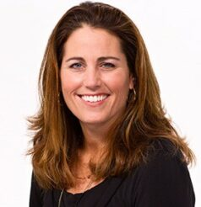
Watch Video 1
Watch Judy: Glamour Interview
As a player, she has competed in 274 matches between 1987 and 2004, serving as captain for 13 of her 17 seasons
Served as president of the Women’s Sports Foundation from 2000-2002 and received the FIFA Fair Play Award for her trip to Pakistan in 1997 to examine the working conditions of factories of her then-sponsor, Reebok
Author of Choose to Matter: Being Courageously and Fabulously YOU, a book for teenage girls and young women on leadership
A founding co-owner of the female majority-owned and operated new women’s professional soccer team in Los Angeles, Angel City FC, that began play in the NWSL in 2022
Key Takeaways:
Discusses her rise to the top as a female soccer player, the hardships she overcame as a female athlete and inspires audiences to persevere through any obstacle
JULIE FOUDY
USA Female Soccer Legend
Fee: $Pending
*Client is responsible for first class, round-trip airfare, ground transportation, hotel accommodations and incidentals for two people for up to two nights

