Slide 1
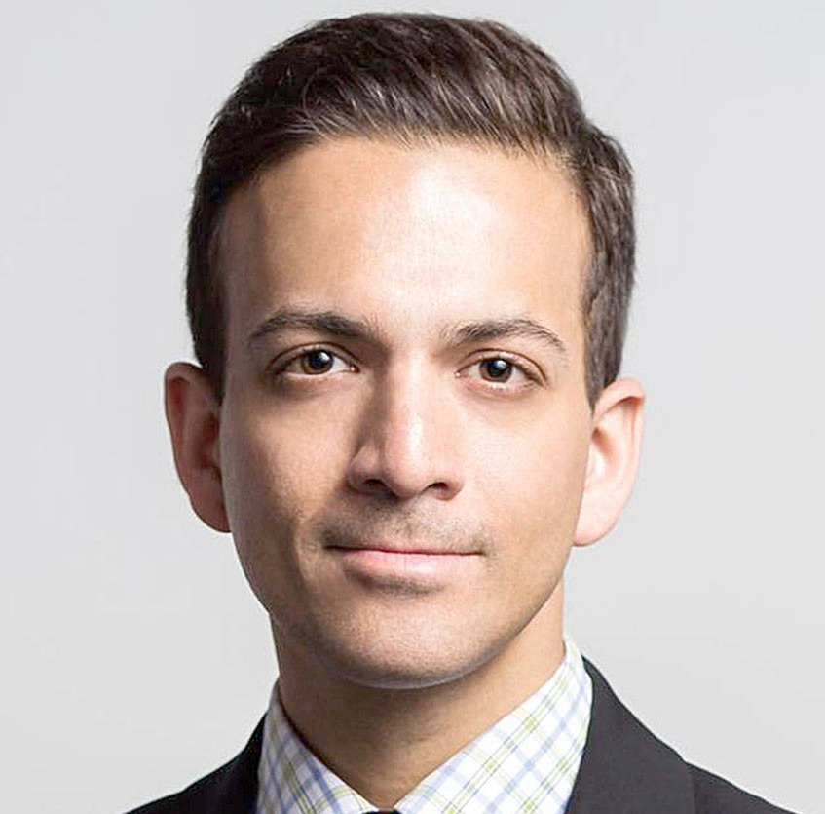
Watch Vin Gupta: Post Pandemic Silver Linings
Described as the second most recognized medical expert (after Dr. Anthony Fauci)
Tech visionary who operates at the heart of disruption to develop solutions to the most-complex challenges in commerce, communication, healthcare and society
Serves as Chief Medical Officer, New Products at Amazon, where he spearheads cutting-edge programs that are leading us into the interdependent futures of healthcare and technology
Known for his forward-looking insights that inspire leaders and their organizations to embrace change, think outside the box to break new ground, and create new inroads to innovation and success, tap into their inner creativity and curiosity as their organizations navigate the changing business environment
Draws from and connects his experiences in tech innovation, healthcare, and the military to share fascinating stories with valuable insights for adapting to the trends that will disrupt businesses, the future of leadership and change management, communicating for maximum impact, and preparing for what’s to come for your organization and in your industry
Roles have included medical analyst for NBC News, contributor to the New York Times, and commissioned officer in the United States Air Force Medical Reserve Corps
Has held research roles at the Centers for Disease Control and Prevention, World Bank, the Center for Global Health Engagement, and Harvard Global Health Institute
Keynote Categories:
Leading Through Change, Disruption and Uncertainty
The Keys to Innovation: Creating Your Organization’s Next Breakthrough
Recruiting and Retention Strategies for a New Era of Work
DR. VIN GUPTA
Renowned Health Policy Expert
Fee: Pending
*Client responsible for round-trip airfare, ground transportation in event city, hotel accommodations and incidentals for up to two nights

