Slide 1
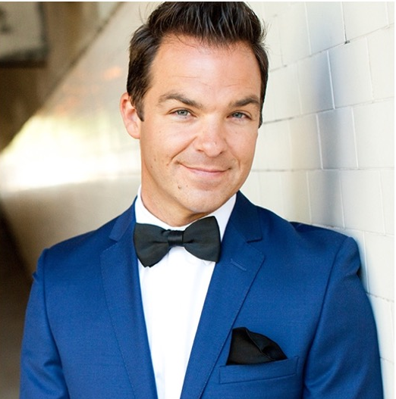
Watch DJ Cory Live
Watch Cory's Hosting Reel
He has worked on some of the most prestigious shows and been a part of some of the most A-List events including the “Glee Season Premiere Event” and the “FOX Fall Premiere Party” where he reported live from the red carpet for fox.com. Cory is the current Warmup Host & DJ for “Dancing with the Stars,” "The Voice," "So You Think You Can Dance,” “America’s Got Talent” and the Grand Daddy of em all…”American Idol!” He has Emceed events for DirecTV, Disney Red Carpet Premieres, AT&T and Apple Computers Inc., just to name a few.
Host of the Emmy nominated, “Pictureka!”, a family game show and host the pilot “Bizarre Comfort Foods” for the Discovery Channel and has hosted several premiers and red carpet events for A-list celebrities and hit TV shows
Cory Almeida is versatile, charming and a consummate professional. So the next time you turn on your TV, look for the guy on the mic, in front of the crowd, or behind the turntables, chances are it’ll be…Cory Almeida!
CORY ALMEIDA
Event Emcee, Conference DJ &
Keynote Speaker
$6,500
*Client is responsible for roundtrip airfare, ground transportation, hotel accommodations and incidentals for up to two nights where required.

