Slide 1
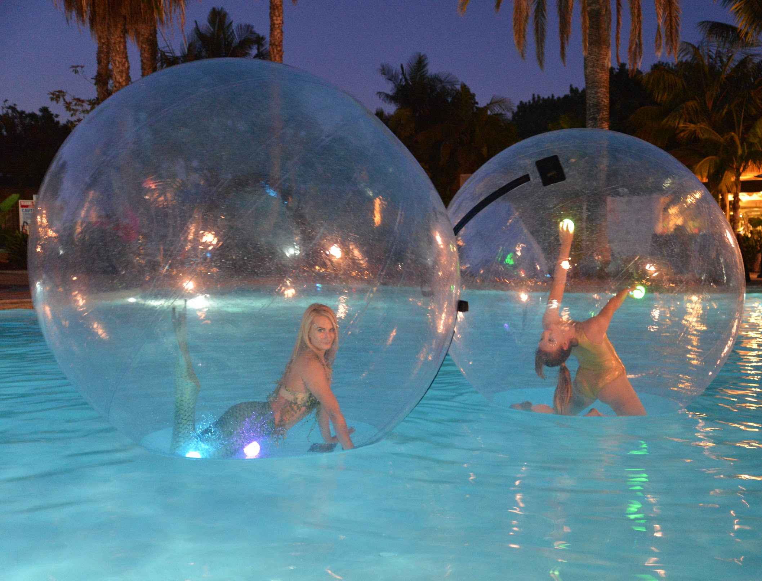
Bubble Sphere package Price $1,875 each
Requirements
Pool Space/ Level floor space
A discreet place to inflate/deflate near the performance area.
Package Includes
1 Bubble Sphere
3 10-minute sets within 1- hour 10-minute break between sets.
Costume
Assistant to help performer in and out of Bubble Sphere
Liability Insurance day of event up to 1 mill
LED options available for night performances

Slide 2
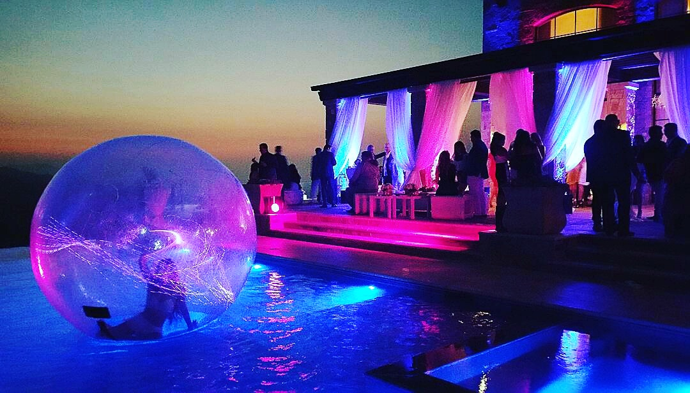
Bubble Sphere

Slide 3
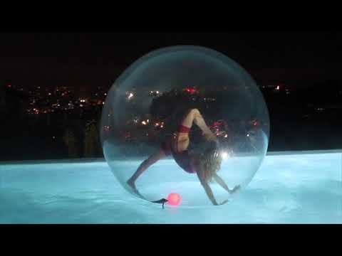
Bubble Sphere

Slide 4
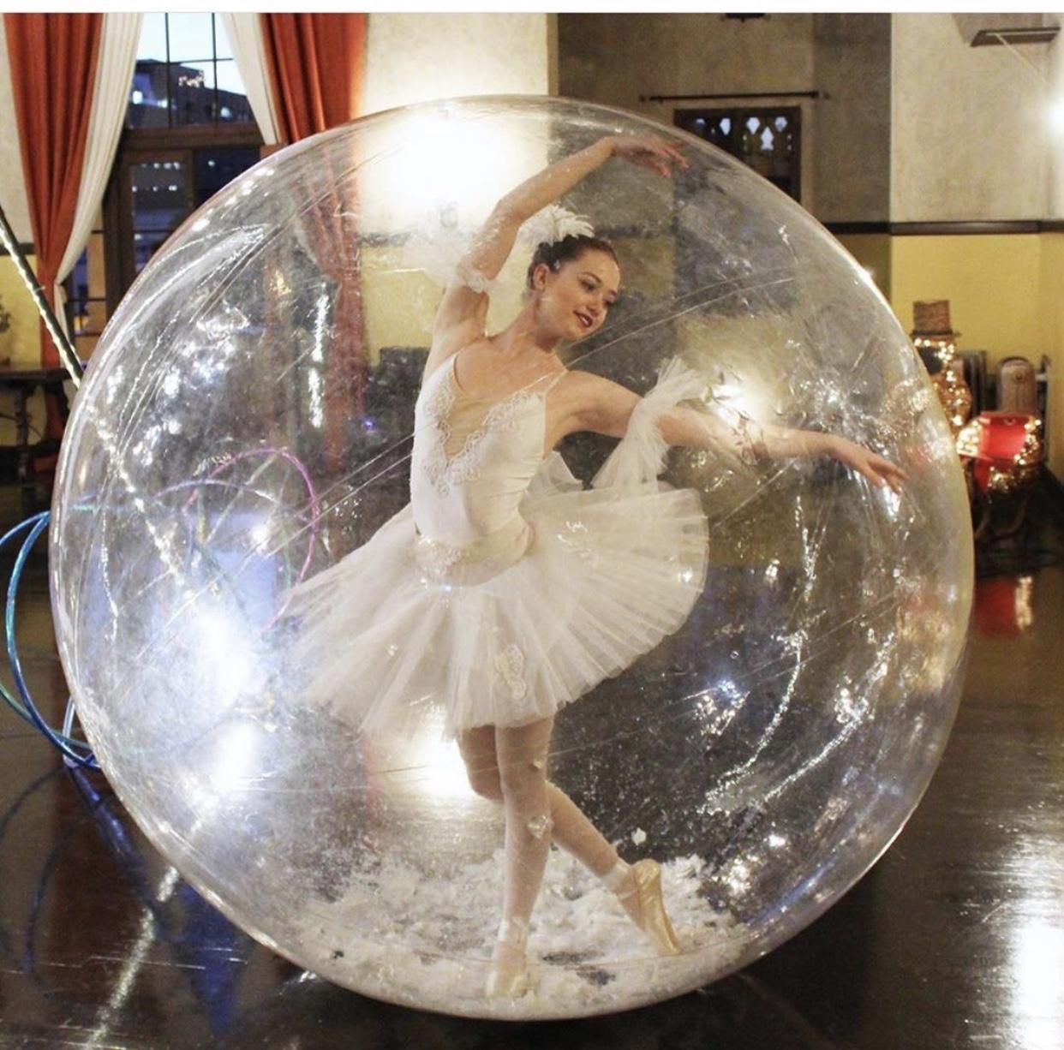
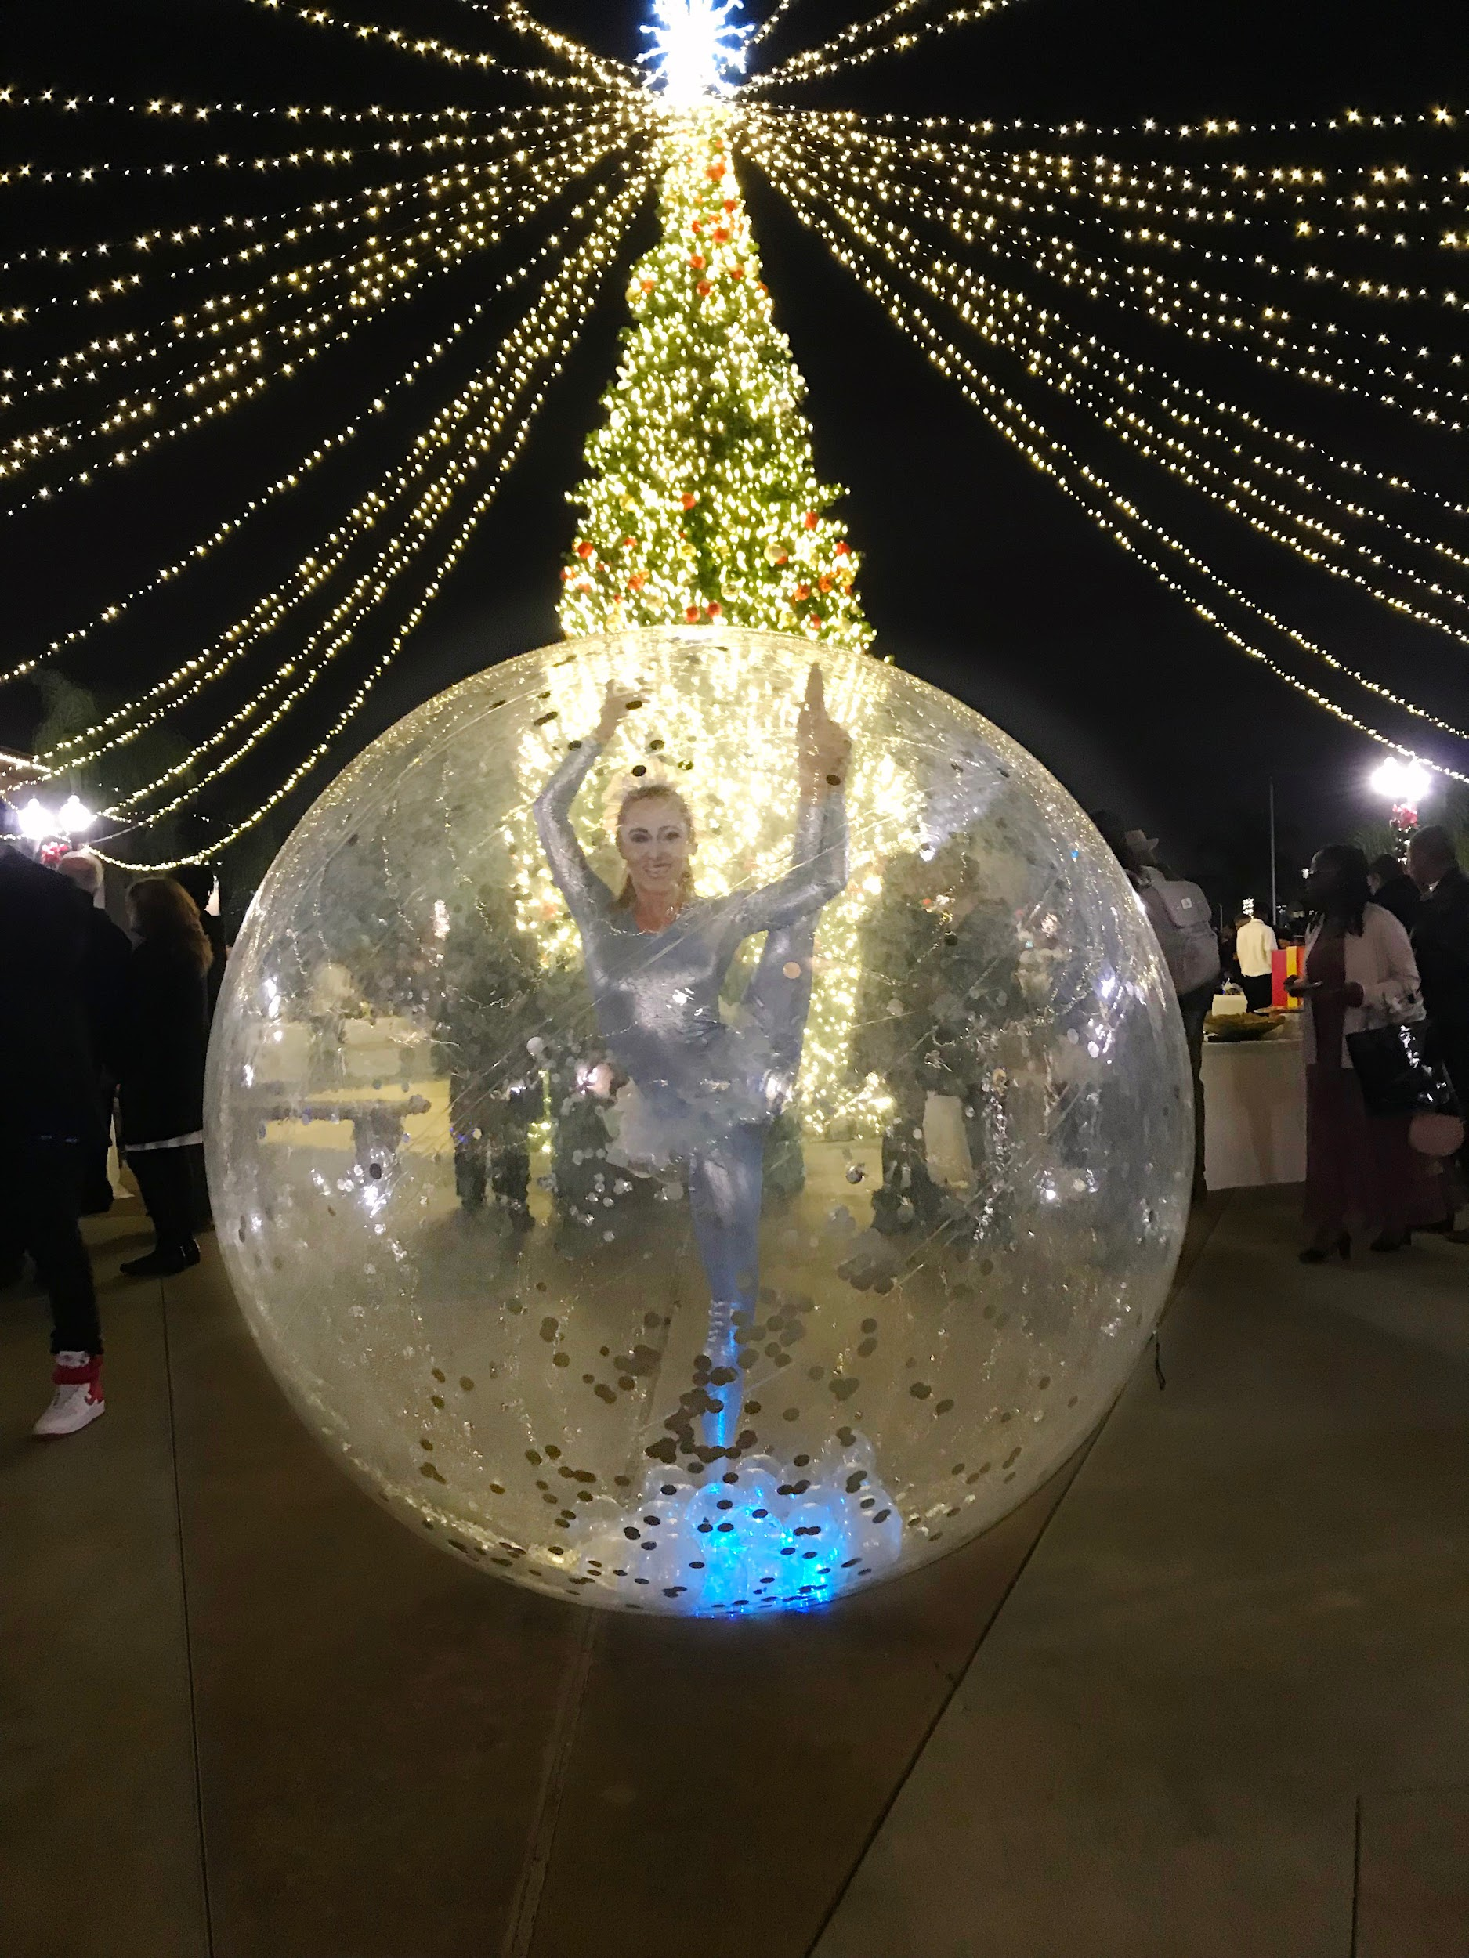
Roaming Bubble Sphere

Slide 5
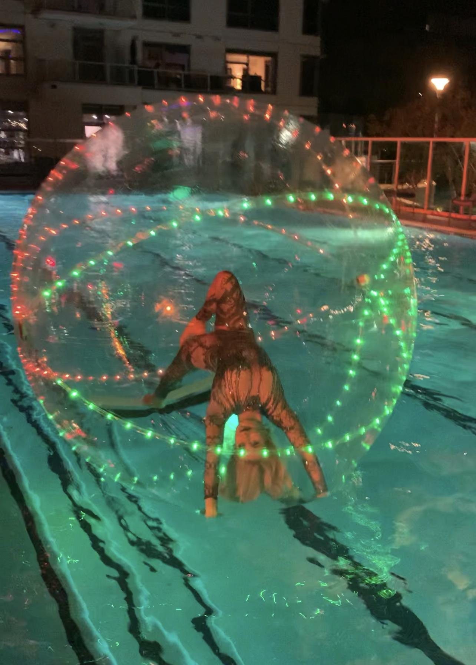
LED Bubble Sphere Package
Price $2,250
Requirements
Pool Space/ Level floor space
A discreet place to inflate/deflate near the performance area.
Package Includes
1 Bubble Sphere
3 10-minute sets within 1- hour 10-minute break between sets.
Costume
Assistant to help performer in and out of Bubble Sphere
Liability Insurance day of event up to 1 mill
LED options available for night performances

