Slide 1
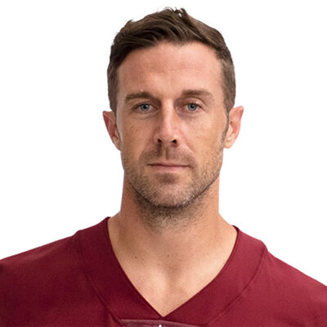
Watch Alex Smith: TED - An NFL Quarterback on Overcoming Setbacks
NFL Analyst and former Quarterback of the Washington Football Team and the Kansas City Chiefs who he led to the playoffs in four out of five seasons
Three-time Pro Bowl nominee in 2014, 2017 and 2018
Holds the 49ers franchise records for the most game-winning drives in a single season and the most 4th quarter comeback wins in a single season
312 consecutive passes attempted without an interception throughout the 2015 season ranks second all-time in NFL history behind Tom Brady
Suffered a severe injury that almost led to the loss of his right leg in 2018 yet returned to the game in 2020 as starting quarterback for the Washington Football Team, leading the team to win the NFC East Division that season
Founder of the Alex Smith Foundation, dedicated to sending foster kids to college and donates 91% of its proceeds to the cause having donated almost $1,000,000 to date
ALEX SMITH
Former Quarterback, NFL Analyst
Fee: $66,000
*Client is responsible for ground transportation, hotel accommodations and incidentals for up to two nights
**Travels from San Francisco, CA

