Slide 1
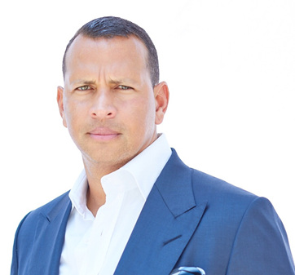
Watch Alex Rodriguez: INBOUND 2018 Spotlight
14x MLB All-Star, record holder for more grand slams than any other player in history, and a 2009 World Series Champion with the New York Yankees, known as one of the world’s greatest athletes
Chairman and CEO of A-Rod Corp, a broad-based investment firm that bets on world-class startups with leading global companies across the real estate, health and wellness, technology, and sports & entertainment industries
Founded A-Rod Corp in 1995, purchasing a duplex apartment ultimately buying units across the southeastern U.S., and building a fully integrated real estate and development company
Joined CGI Merchant Group's hotel investment fund to acquire and develop properties across North America and the Caribbean in 2020
CEO of Slam Corp, a special purpose acquisition company, member of the ownership group of the NBA’s Minnesota Timberwolves and Minnesota Lynx
Emmy Award-winning analyst for Fox Sports and ESPN, former investor on ABC’s Shark Tank and mentor of financially distressed ex-athletes on CNBC’s Back in the Game
Keynote Topics:
Mindset of a Champion: A Moderated Discussion and Q&A with Alex Rodriguez
Success Across Sectors: Critical Advice for Growth and Innovation
Resilience: How to Stay in the Game When Challenges Arise
ALEX RODRIGUEZ
Chairman & CEO of A-Rod Corp
Fee: $120,000
*Client is responsible for first class ground transportation, hotel accommodations and incidentals for up to two nights
Local to Florida

