Slide 1
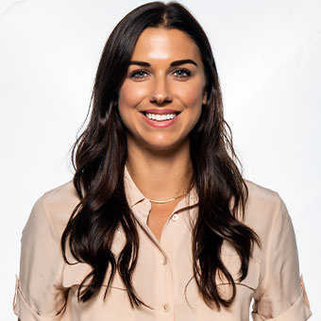
Watch Alex Morgan: Discusses World Cup Era on Just Women's Sports
Watch Alex Morgan: Talks Equal Pay with Megan Rapinoe
Two time World Cup Champion, co-captain of the US Women’s National Team and Olympic gold medalist, she is considered one of the greatest soccer players of all time
Additional accolades include collegiate All-American, U.S. Soccer Female Athlete of the Year, 2012 winner of the Best Breakthrough Athlete Award at the ESPY’s and was a finalist for the FIFA World Player of the Year making her the gold standard when it comes to women’s soccer
Best-selling author of the book series, The Kicks, for middle-grade readers, the first book in the series reaching $7 on the New York Times Bestsellers life for middle-school children
Co-Founder of TOGTHXR, a media and commerce company focused on rick storytelling routed in lifestyle and youth culture
Key Takeaways:
As an athlete, businesswoman, author, model and mom, she captivates audiences with her determination and inspires with her stories of fighting for equality, motivations behind starting her media company and how to successfully wear multiple hats
ALEX MORGAN
World Champion Soccer Star
Fee Pending
*Client is responsible for roundtrip airfare, ground transportation, hotel accommodations and incidentals for up to two nights

