Slide 1
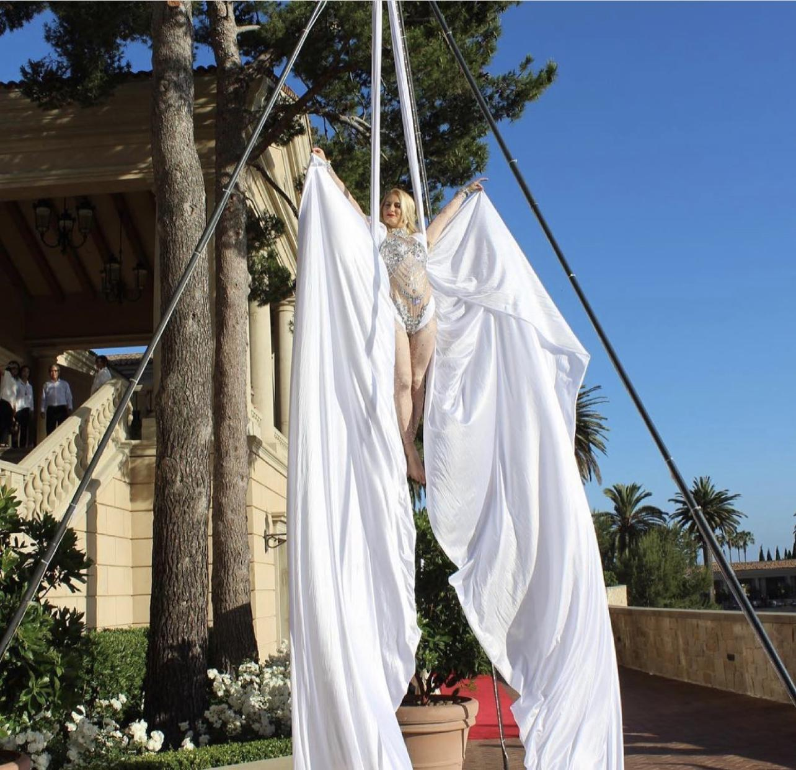
Aerial Silks Package
Price $3,125
Requirements
Minimum 19 ft ceiling clearance
16ft by 16ft equilateral triangle of level floor space.
Package Includes
Tripod Rigging System
Your choice of Aerial Act
Setup and teardown of equipment
Aerial performer 3 10-minute ambiance sets with at least a 10-minute breaks between sets.
Costume
Liability insurance day of event 1 mill
LED Lighting of show on rigging for night performance. (power outlet access is required.)

Slide 2
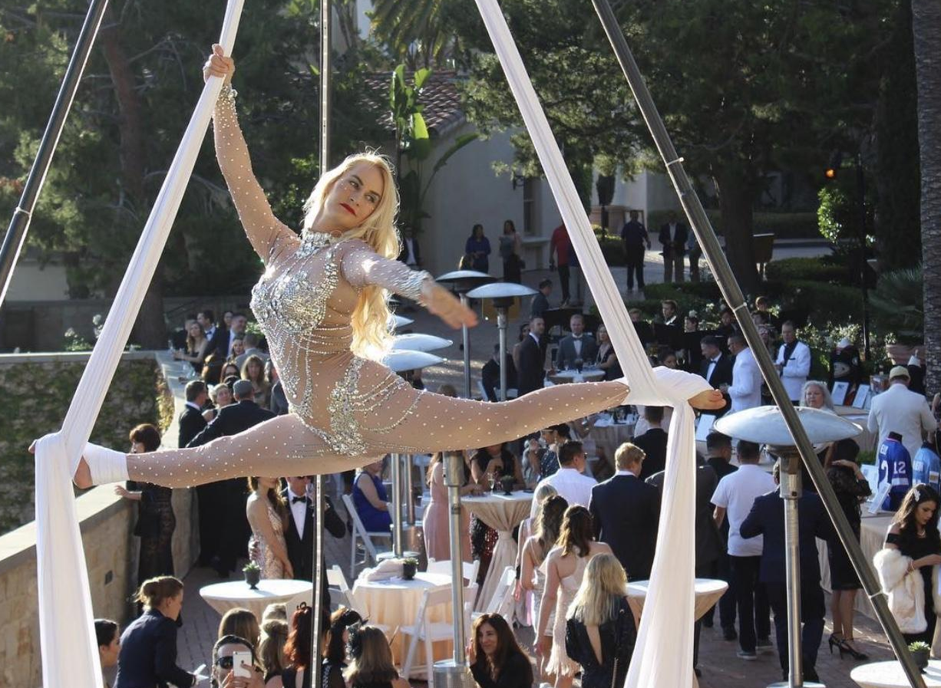
Aerial Silks

Slide 3
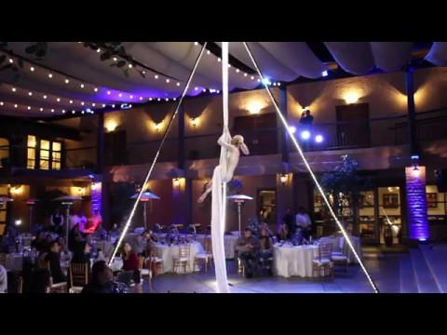
Aerial Silks Routine Video

