Slide 1
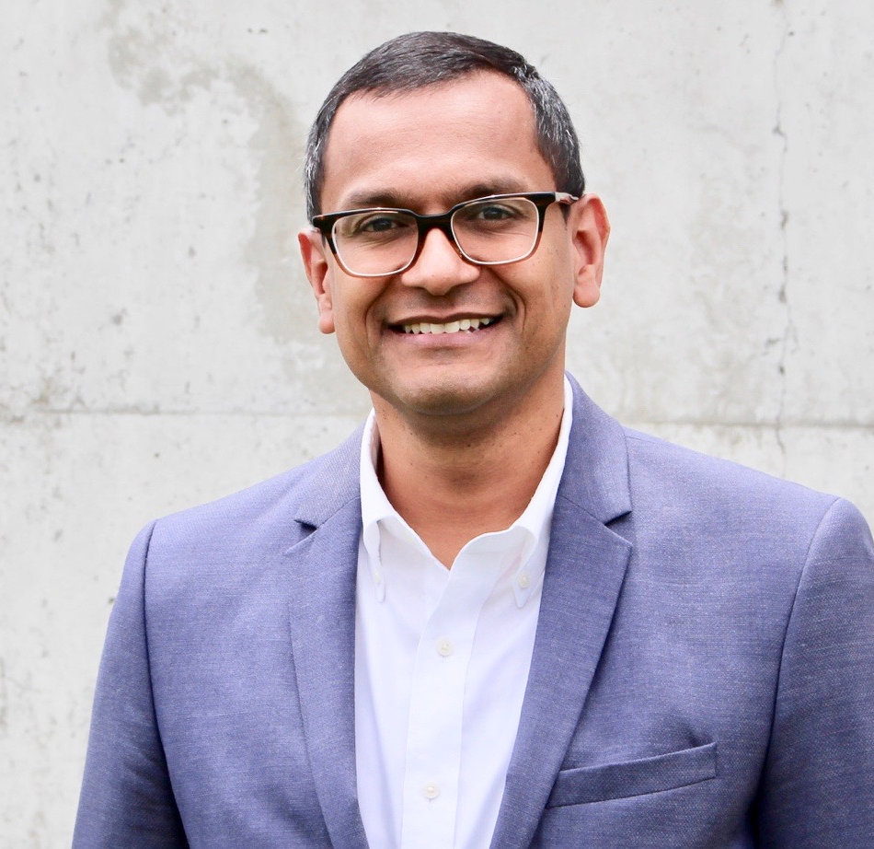
Watch Pandit Dasa: LEAD2017
Watch Pandit's Speaker Reel
Mindful Leadership Expert, author and former monk of 15 years, who presents the latest in scientific research on Mindfulness and has spoken to many Fortune 500 and Fortune 100 companies inspiring leaders or those aspiring for leadership positions to manage and lead mindfully and without ego.
Author of Urban Monk, in which he recounts the turning point in his life that came after his family lost their multimillion-dollar business, which ultimately led him to living as a monk for 15 years in New York City
Has over 13,000 hours of personal meditation practice which he uses to teach mindfulness techniques that can be used to reduce stress and boost emotional intelligence
Has been featured in the Wall Street Journal, Inc. Magazine, PBS, NPR, The New York Times, Psychology Today and writes for HuffPost
Key Takeaways:
How to develop positive social connections in a hybrid workplace
Research and benefits of Practicing mindfulness at work
Tips on how to shift our mindset to lean and grow from life’s challenges
Learning to strengthen the mind and develop a positive mindset
Sample Keynote Topics:
The Future of Work and Mindful Leadership
Creating A Mindful and Positive Workplace Culture
Developing Resilience During Change
A Mindful Approach To Team Building
Stress Management and Work-Life Integration
PANDIT DASA
Workplace Culutre &
Mindfulness Expert
$20,000
*Client is responsible for first class, round-trip airfare, ground transportation in event city, hotel accommodations and incidentals for up to two nights

