Slide 1
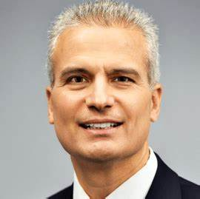
Watch John Sitilides: Lockton Global Growth Forum
Watch John Sitilides: Royal Bank Presentation
Watch John Ted Talk
John Sitilides is Principal at Trilogy Advisors LLC in Washington, D.C., specializing in U.S. government relations, geopolitical risk, and international affairs, and Senior Fellow, National Security Program, at the Foreign Policy Research Institute.
He explores the complex geopolitical and geo-economic decisions that impact markets in Asia, Europe, the Middle East, and worldwide, helping corporate executives, investment managers and civic audiences better understand, anticipate, and mitigate risk.
Sitilides is the Southern Europe Regional Coordinator at the Foreign Service Institute, the State Department's professional development and diplomacy academy for American foreign policy professionals.
He is a member of the Association of International Risk Intelligence Professionals, the Intelligence and National Security Alliance, the Columbia University Club of Washington, D.C., the Empire State Forum, and the Association of Former Senate Aides.
Keynote Topics:
Washington and the World: The New Geopolitics of Great Power Rivalry
Geopolitics, Geo-Economics, and Great Power Threats to Global Supply Chains
The Big Picture: A Geopolitical and Geo-Economic Outlook
China, Russia, and America: Geopolitics & Geo-Economics in the Decade Ahead
Geopolitical Turmoil, Global Shipping & Supply Chain Management
Global Risk & Geopolitical Strategies: The Decade Ahead
John Sitilides
Geopolitical Speaker
Fee: $20,000
*Client is responsible for round-trip airfare, ground transportation, hotel accommodations and incidentals
** John travels from Washington, DC

