Slide 1
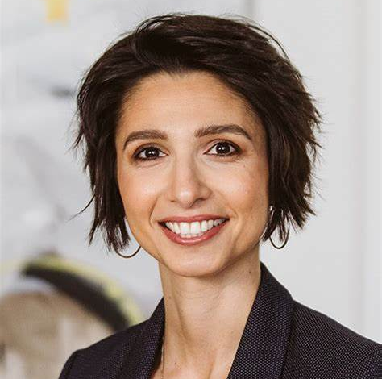
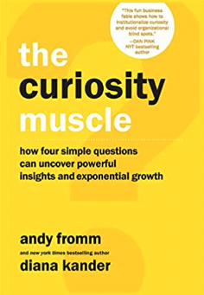
Watch Diana's Unleash Your Curiosity
Watch Diana Kander: Our Approach to Innovation is Dead Wrong
Known for her unrelenting curiosity leading her to ask some of the biggest questions in business: How did Kodak invent the digital camera and still go out of business? What does Amazon do behind the scenes to engineer one breakthrough after another? And how has Snoop Dogg continued to innovate decade after decade to stay relevant to each generation?
Serial entrepreneur who has helped create multi-billion dollar products, coached boards and executive committees on innovation best-practices, and implemented culture transformations
Has spent her career challenging assumptions and asking thought-provoking questions, revolutionizing the way businesses look at innovation and curiosity
New York Times bestselling author whose books have been taught in over 100 universities.
Credited with cracking the code on how curiosity can serve as the catalyst for exponential growth, and she thrives on helping audiences understand that they can get better results if they learn how to ask better questions
Sample Keynote Topics:
Unleash Your Curiosity
Go Big or Go Home
Customized Keynote
DIANA KANDER
Renowned Innovation Consultant
Fee: $20,000
*Client is responsible for $2,000 travel buyout, hotel accommodations and incidentals for up to two nights

