Slide 1
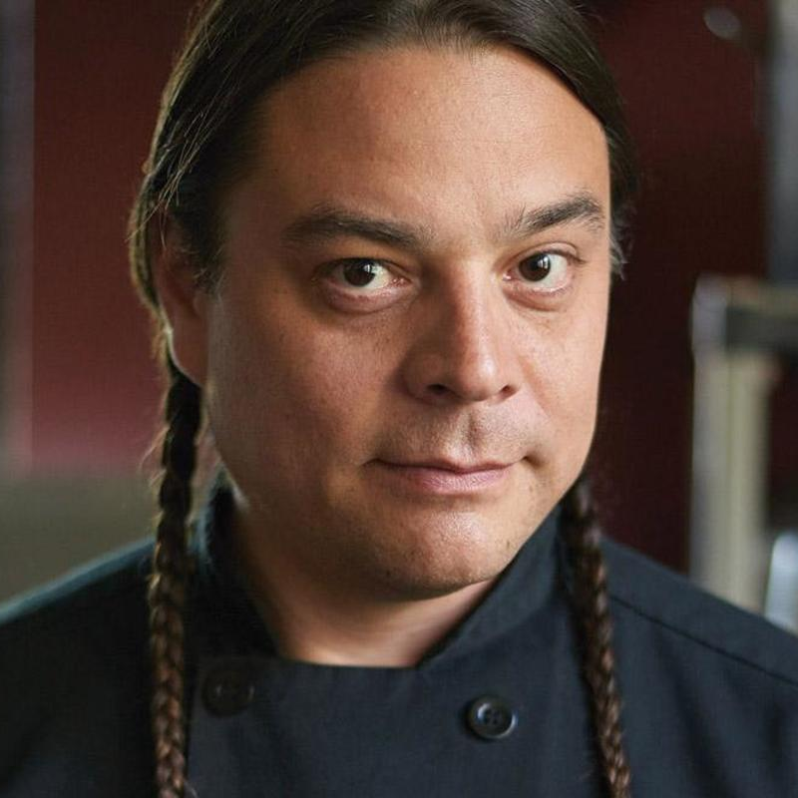
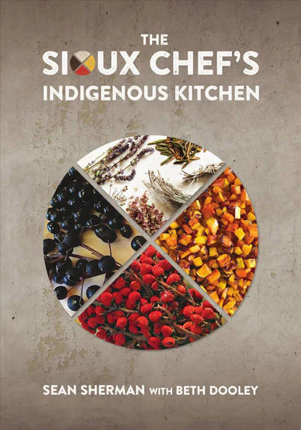
Watch Chef Sean Sherman: Tex Talk
Chef Sean Sherman has dedicated his career to supporting and promoting Indigenous food systems and Native food sovereignty.
Sean’s cooking style is based on pre-colonial Indigenous food systems, using only ingredients that are native to North America.
His menus are inspired by the seasons and the land, featuring traditional ingredients like bison, hand-harvested wild rice, cedar, and sumac.
Through his activism and advocacy, Sean is helping to reclaim and celebrate the rich culinary heritage of Indigenous communities around the world.
“Our ancestors understood how-to live-in balance with the natural world. Indigenous foods are the original foods of this continent. It’s important we recognize that and start celebrating those foods.”
Chef Sherman is empowering Native people to use the power of their history and culture to counter the multigenerational impacts of colonialism and dispossession, and to combat systemic cultural genocide.
RESTAURANTS:
Owamni (Minneapolis, Minnesota)
Chef Sean Sherman The Sioux Chef
Fee Pending
*Client is responsible for business class, round-trip airfare, ground transportation, hotel accommodations and incidentals for up to two nights

