Slide 1
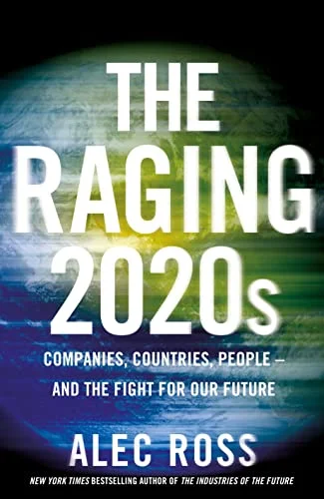
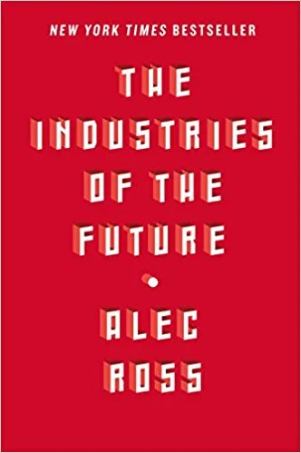
Watch Alec Ross: Interview with Hillary Clinton
Watch Alec Ross: Ted Talk
Was a Distinguished Senior Fellow at Johns Hopkins University and a Senior Fellow at the Columbia University School of International & Public Affairs and a Board Partner at Amplo, a global venture capital firm
Served as Senior Advisor for Innovation to the Secretary of State, to help modernize the practice of diplomacy and advance America’s foreign policy interests during the Obama Administration
Served as the Convener for the Technology & Media Policy Committee on Barack Obama’s 2008 presidential campaign and on the Obama-Biden Presidential Transition Team
2X Author including the New York Times bestselling The Industries of the Future, described as a fascinating vision od what’s next for the world and how to navigate the changes the future will bring
Named Top 100 Global Thinkers by Foreign Policy Magazine
Keynote Topics:
The Industries of the Future
Foreseeing the Next Wave of Marketplace Opportunities
Understanding the Geopolitics of our Networked world
ALEC ROSS
Leading Expert on Innovation
$25,000
*Client is responsible for round-trip airfare, ground transportation, hotel accommodations and incidentals for up to two nights

