Slide 1
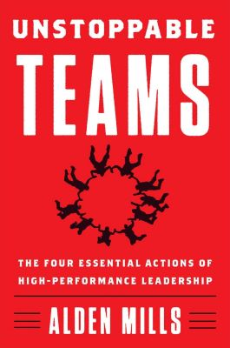
Watch Alden Mills
Watch Alden Mills: Performance Leadership
Former U.S. Navy SEAL platoon commander
Founded Perfect Fitness in 2002, a company which gained national acclaim through Inc. Magazine as the fastest growing consumer products business in the U.S. growing from $500k to over $63M in just three years
Has received over 60 U.S. and foreign design patents for products totaling over $10M
Creator of five #1 ranked infomercials
Author of 2 books: "Be Unstoppable: The Eight Essential Actions to Succeed at Anything“ released in 2013, followed by "Unstoppable Teams: The 4 Essential Actions of High-Performance Leadership" in 2019
Keynote Topics:
Unstoppable Mindset: The Mentality & Tools for Achieving Your Full Potential
Be Unstoppable: The Science & Secrets of Persistence
Be Bold, Be Unstoppable
ALDEN MILLS
Former U.S. Navy SEAL,
Founder at Perfect Fitness
Fee: $23,500 ++
*Client is responsible for ground transportation in event city, hotel accommodations and incidentals for up to two nights

