Slide 1
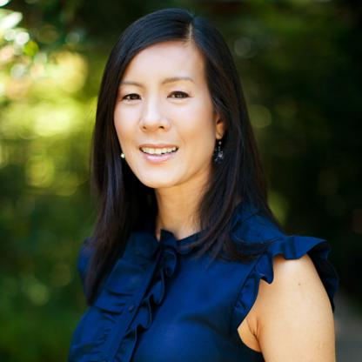
Watch Aileen Lee
Venture capital investor and founder of Cowboy Ventures
Coined the Silicon Valley term “unicorn”, a privately held startup that has a valuation of $1 billion or more
Joined VC firm Kleiner Perkins Caufield & Byers in 1999 where she remained for 13 years
Cowboy Ventures is one of the first female-led venture capital firms and has received three large funds in the last six years, the most recent reaching $95 million
Co-founded All Raise, a non-profit organization which seeks to increase the amount of funding that female investors receive
Named to the Forbes list of The World’s 100 Most Powerful Women in 2020 and TIME’s lists of 100 Most Influential People in 2019.
AILEEN LEE Investor, Founder of Cowboy Ventures
Fee: Pending
*Client is responsible for business class round-trip airfare, ground transportation, hotel accommodations and incidentals for up to two nights

