Slide 1
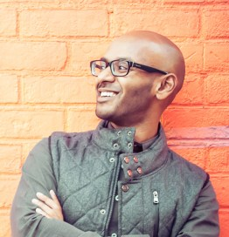
Watch Ahmen Sivaloganathan: Hip-Hop and Social Impact
Described as the Batman of Social Impact, a nonprofit leader by day and hip-hop artist by night
Serves as the CEO of Our Turn, the nation’s leading movement of students fighting for education justice
Uses the power of music to spark changemaking, partnering with young people, professionals, and organizations to advance transformative change in the arenas of education, justice reform, mental health, civic engagement, and more
Has delivered performances and keynote talks in partnership with the World Economic Forum, Stanford Social Innovation Review, Net Impact, NYU, Penn State, the University of San Diego, Independent Sector, Fordham, Synergos Institute, Centre for Social Innovation, Defy Ventures, the World in Conversation Project, and many more
Awarded as a “40 Under 40 Rising Star” by New York Nonprofit Media and a “Next Generation Leader” by the Human Services Council, and was featured in Good is the New Cool, an Amazon Philanthropy & Charity #1 new release
Keynote Topics:
Troublemaking is a Force for Good
I’m Not What You Expected
Being a Father Makes Me a Better CEO
AHMEN SIVALOGANATHAN Leading Voice for Change
Fee Pending

