Slide 1
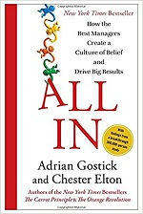
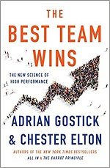
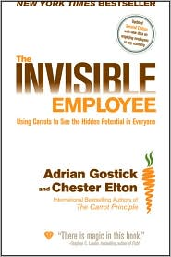
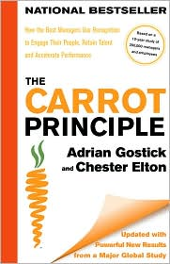
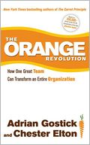
Watch Adrian Gostick: Showreels
Author of the New York Times, Wall Street Journal, and USA Today bestselling books, The Carrot Principle, All In, Leading with Gratitude and Anxiety at Work which have been translated into 30 languages and have sold more than 1.5 copies worldwide
Recognized as a workplace expert and was called “creative and refreshing” by the New York Times and “fascinating,” by Fortune magazine for his guidance on building culture, managing change and leading high-performance teams
Founded The Culture Works, a workplace training and consulting company focused on helping organizations building high-performance work cultures
Writes on leadership strategy for Forbes, has been quoted in The Economist, Newsweek and the Harvard Business Review and has appeared on NBC’s Today Show and CNN
Named a top 10 Global Guru in Leadership and Organizational Culture in 2021
Keynote Topics:
Building an All-In Culture, Managing Change and Enhancing Engagement
The 5 Disciplines of Today's Most Effective Work Groups
8 Leadership Practices for Extraordinary Business Results
ADRIAN GOSTICK
Expert on Corporate Culture
Fee: Pending
*Client is responsible for business class, round-trip airfare, ground transportation in home and event cities, hotel accommodations and incidentals for up to two nights

