Slide 1
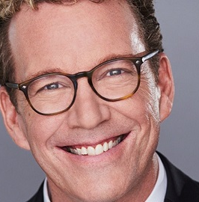
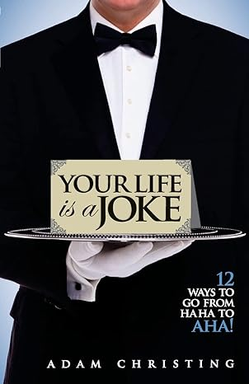
Watch Adam Christing: Showreel Video
Watch Adam Christing: Emcee Video
Top Booked Emcee, After-Dinner Speaker, Interactive Entertainer, Comedian, and Magician
Adam works with organizations who want to experience how the magic of laughter can open doors and hearts in business and in life.
ExxonMobil executive Mark Green dubbed him the “Tom Brady of emcees.” Adam has delighted corporate, association, and non-profit audiences in 49 of the 50 U.S. states, Canada, Europe, and China.
In 2021, he received the “Best of Los Angeles Award” as the #1 Event Master of Ceremonies.
He has appeared on more than 100 radio and TV shows, including CNN, Fox News, Entertainment Tonight, and NBC Nightly News.
He’s also been featured in national magazines and newspapers, including USA Today, FORTUNE, and The New York Times.
He is the author of three personal growth and humor books published by Random House and Markin Books.
His forthcoming book is called The Laughter Factor: The 5 Habits of Humorous People.
Keynote Topics:
YOU CAN DO MAGIC!
WE GOT YOU
LAUGH FOR A CHANGE
Adam Christing
Speaker, Emcee, Comedian
Fee: $20,000 – 30,000
*Client is responsible for round-trip airfare, ground transportation, hotel accommodations and incidentals
** Adam travels from Los Angeles, CA

