Slide 1
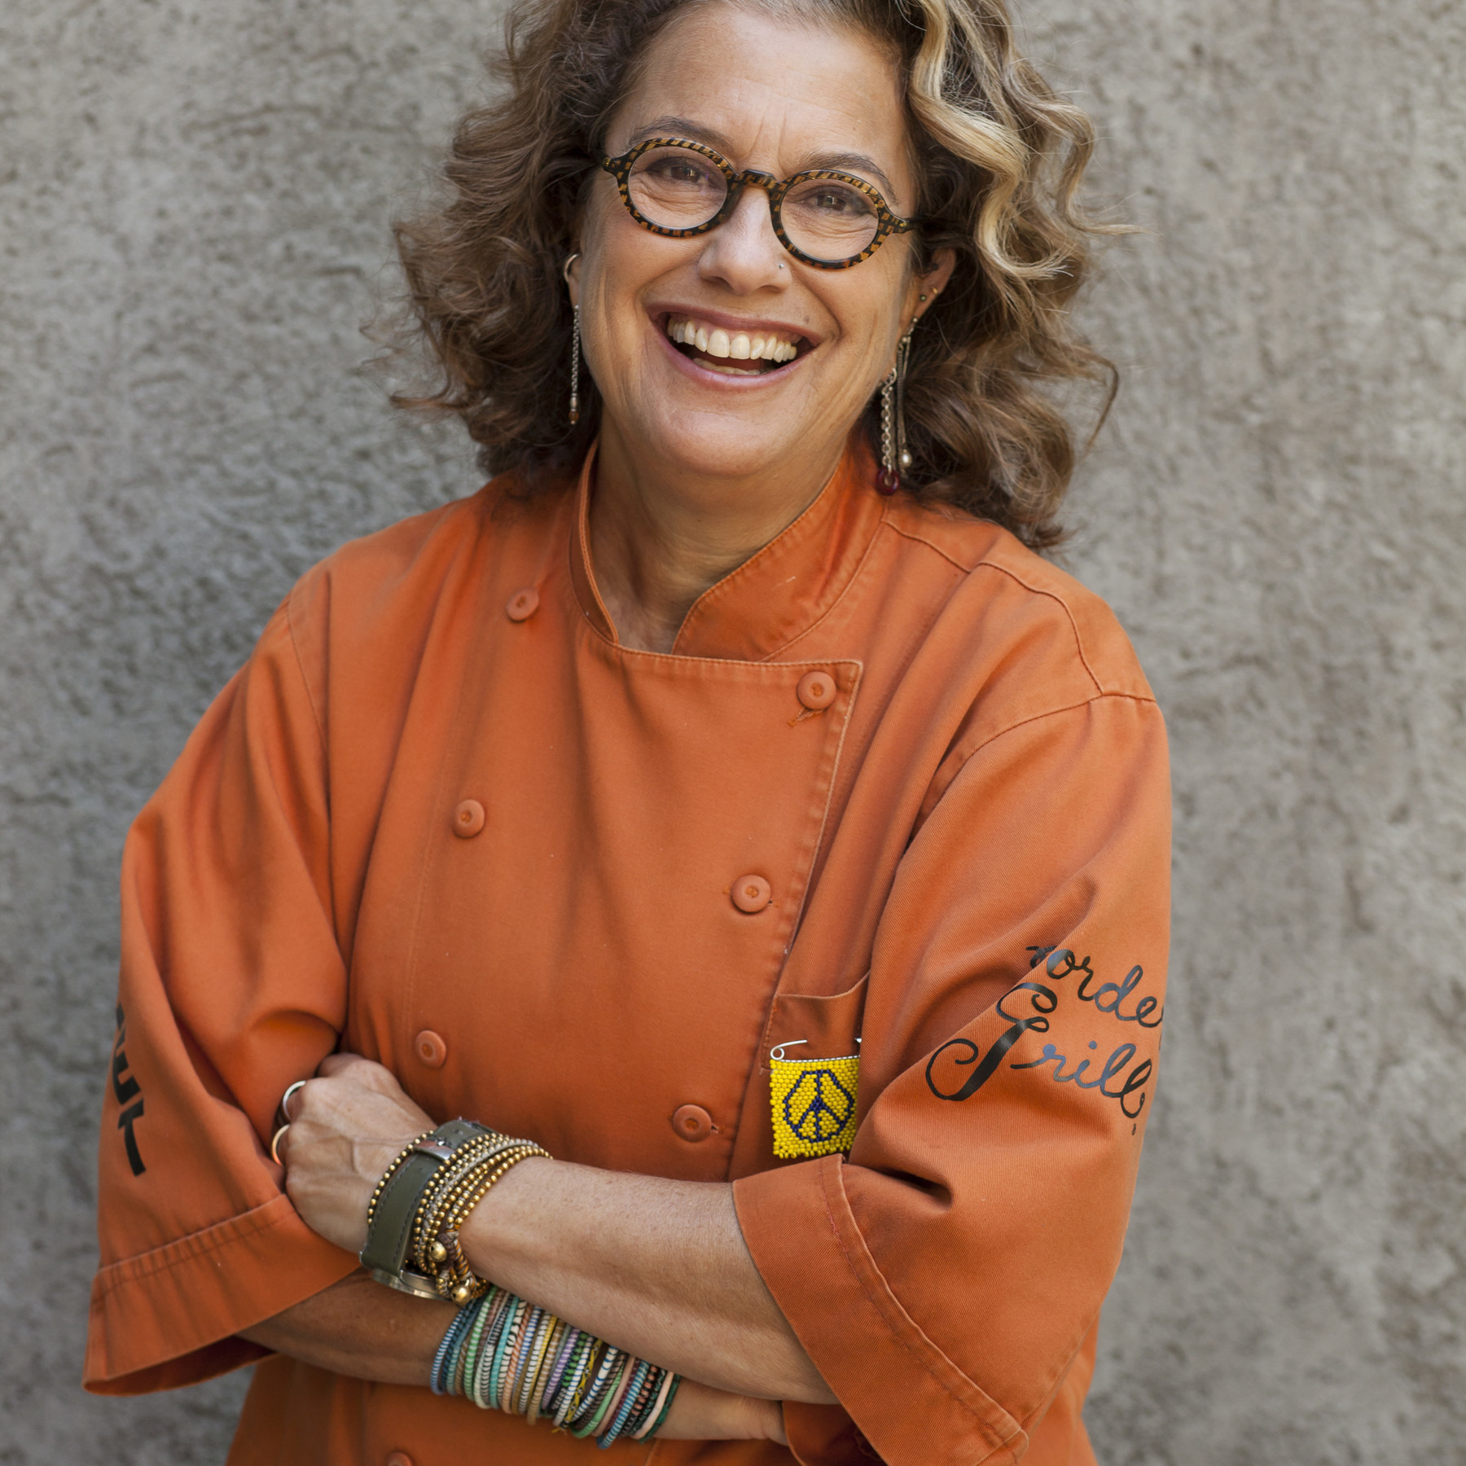
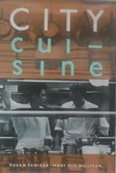
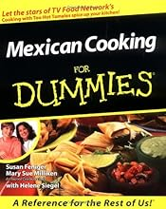
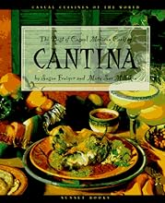
Watch Susan Feniger: My Culinary Voice
Iconic culinarian, author, and entrepreneur best known for her Modern Mexican concept, Border Grill and her appearances with longtime business partner, Mary Sue Milliken, on Too Hot Tamales and Tamales World Tour in the 1990s
4X James Beard Foundation Award nominee and winner of the award in 1985 un the Who’s Who of Food & Beverage category
Owned and operated several restaurants throughout her successful career including City Café which forever changed L.A.’s culinary landscape by introducing eclectic dishes from around the world, BBQ Mexicana, Socalo and most recently Pacha Mamas
Competed on Bravo’s Top Chef Masters in 2010
Along with Mary Sue Milliken, was named the recipient of the fourth annual Julia Child Award from The Julia Child Foundation for Gastronomy and the Culinary Arts, making them the first women to be honored
Additional accolades include the Elizabeth Burns Lifetime Achievement Award from the California Restaurant Association in 2013, induction into Menu Masters Hall of Fame in 2014, and the 2018 Gold Award from the Los Angeles Times for culinary excellence and innovation in Southern California
Sits on the boards of the Scleroderma Research Foundation, Los Angeles LGBT Center, and L.A. Tourism & Convention Board and works closely with Share Our Strength and Human Rights Campaign
Southern California Restaurants:
Socalo (Santa Monica, CA)
SUSAN FENIGER
$45,000
*Client is responsible for business class, round-trip airfare, ground transportation, hotel accommodations and incidentals for up to two nights

