Slide 1
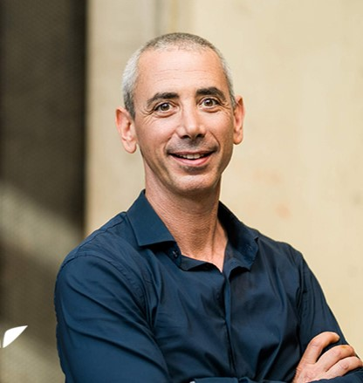
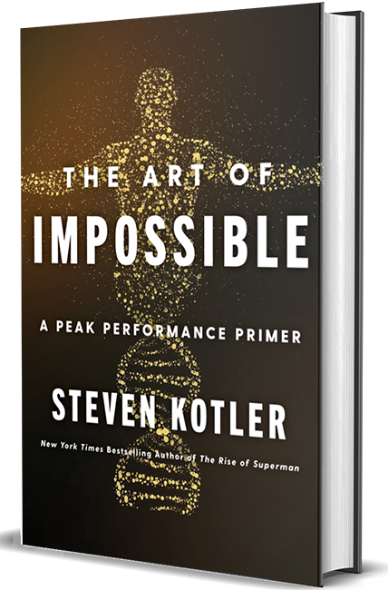
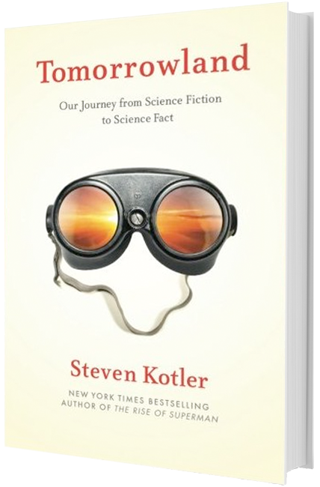
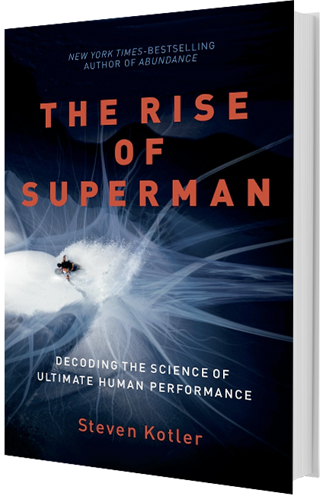
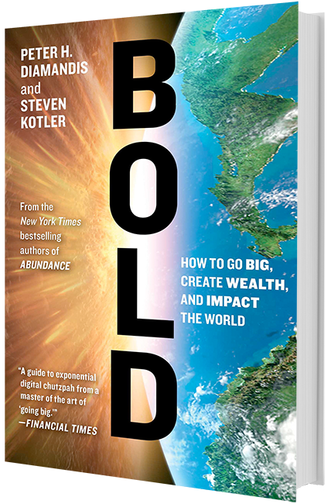
Watch Steven Kotler: The Scientifie of Maximizing Human Potential
Executive Director of Flow Research Collective, a peak performance research and training institute which trains individuals to harness the power of flow to achieve more, faster
Considered one of the world’s foremost experts on individual and group performance
Has trained more than 250,000 people, among them Olympians, Navy SEALS and employees from companies including Google, Deloitte and Microsoft
Author of 14 books, 11 of which have become bestsellers
Newest book The Art of the Impossible: A Peak Performance Primer has been described as “an inspiring approach to life-hacking that begs to be implemented”
Key Takeaways:
He’ll explain the science and research behind the state of flow––and how it can increase productivity, creativity, and learning speeds by up to 500 percent. You’ll walk away with tools to reduce stress and overwhelm, decrease procrastination and distraction, and increase motivation and performance.
Sample Keynote Topics:
The Art of Impossible: Achieving and Sustaining Organizational Peak Performance
The Superman Leader: Leverage Flow to Heighten Personal and Organizations Performance
The Future is Faster Than You Think: Preparing for the Next Wave of Technology
STEVEN KOTLER New York Times Bestselling Author and Leading Expert on Human Performance; Foremost Authority on Harnessing Flow to Amplify Focus, Decision-Making and Productivity

