Slide 1
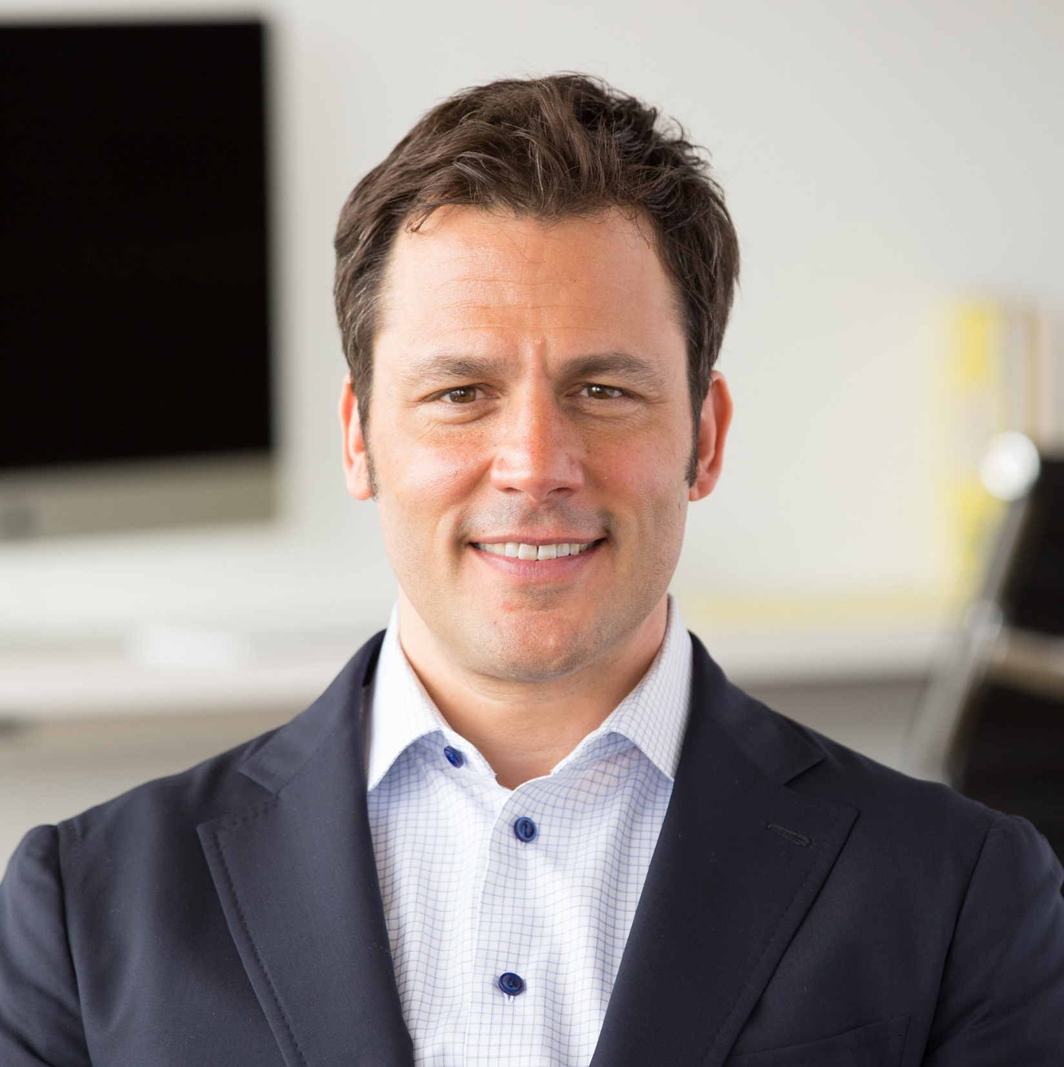
Watch Ryan Estis: Speaker Promo Reel
Watch Ryan Estis: Pouring Happens
Brings more than 20 years of experience as a top-performing sales professional and leader, having served as the former chief strategy officer for the McCann Worldgroup advertising agency NAS
Known for his innovative ideas on leading change, improving sales effectiveness and preparing for the future of work, his presentations emphasize actionable content designed to elevate business performance and emerging trends influencing leadership effectiveness, sales performance and customer experience
Has been recognized as one of “the best keynote speakers ever heard” by Meetings & Conventions magazine alongside Tony Robbins, Bill Gates, Colin Powell and Mike Ditka
Faculty member for the Institute of Management Studies, a member of the SmartBrief on Workforce Advisory Board and a certified Human Capital Strategist
Author of a popular blog on business performance and his writing has been featured in Inc., Forbes, Entrepreneur, FastCompany, SmartBrief, Business News Network, Crain’s Business, and Yahoo Business
Key Takeaways:
Encourages listeners to challenge conventional leadership practices and explores progressive techniques and technology that pace with the evolving needs of today’s knowledge worker
Sample Keynote Topics:
Adapt & Thrive
Human Centered Leadership
Unleash Your Inner Superhero
RYAN ESTIS
Innovator, Business Leader

