Slide 1
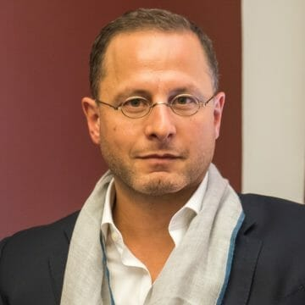
Watch Rawi Abdelal: Dignity, Equity and Populism
Watch Rawi Abdelal: Panel on Geopolitics in the Digital Age
Recognized as one of the world’s foremost authorities on how globalization and geopolitics affect businesses, economies, supply chains and social structures
Herbert F. Johnson Professor of International Management at Harvard Business School, faculty co-chair of the Bloomberg-Harvard City Leadership Initiative and faculty chair of the Harvard Business School/YPO Presidents’ Program
Work focuses on empowering organizations to save capitalism from the ground up, suggesting many actions organizations can take to do this require little or no financial investment
Widely published author and an eloquent and inspiring speaker, educator and storyteller who teaches about global financial systems, international politics, the influence of multinational firms on world politics, the transformation of energy markets, and policies affecting and emerging from Russia, China and India
Key Takeaways:
Discussions help business leaders understand the macro and micro forces driving current trends, how to make sense of the world we’re living in, and what they can do to help build a more sustainable, equitable future.
Sample Keynote Topics:
Imagining the Next Global Economy
Chekhov’s Gun: How the Conflict in Ukraine Will Affect the Future of Business and Society
How Businesses and Governments Can Mitigate Disinformation
Rawi Abdelal
Geopolitical Trends
$35,000
*Client is responsible for business class, round-trip airfare, ground transportation, hotel accommodations and incidentals for up to two nights
*Travel from Cambridge, MA

