Slide 1
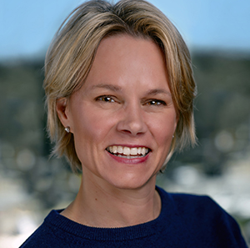
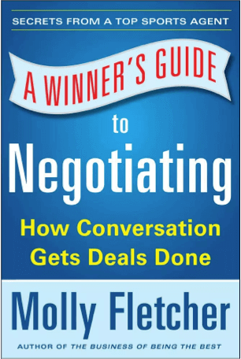
Watch Molly Fletcher: Unleash Your Potential
One of the first female sports agents, hailed as the “female Jerry Maguire” by CNN
Served as President of CSE for nearly two decades, a role in which she negotiated over $500M in contracts and represented over 300 of sports’ biggest names
5X author including The Energy Clock, Fearless at Work and A Winner’s Guide to Negotiating
Founder and host of the Game Changes with Molly Fletcher podcast where she interviews experts and celebrities across industries including Arthur Blank, John Mackey, Matthew McConaughey, Priyanka Chopra Jonas and Simon Sinek among others
Insights have been featured in prestigious media outlets including CNN, ESPN, Forbes, Fast Company, InStyle and Sports Illustrated
Founder of The Molly Fletcher Company, through which she helps leaders transform workplace complacency and shares the business wisdom, relationship brilliance and unwavering optimism that helped her thrive as one of the first female sports agents and now as a successful entrepreneur
Keynote Topics:
Fearless At Work
A Winner’s Guide to Negotiating
The Business of Being the Best
MOLLY FLETCHER
Renowned Sports Agent
Fee: $45,000+

