Slide 1
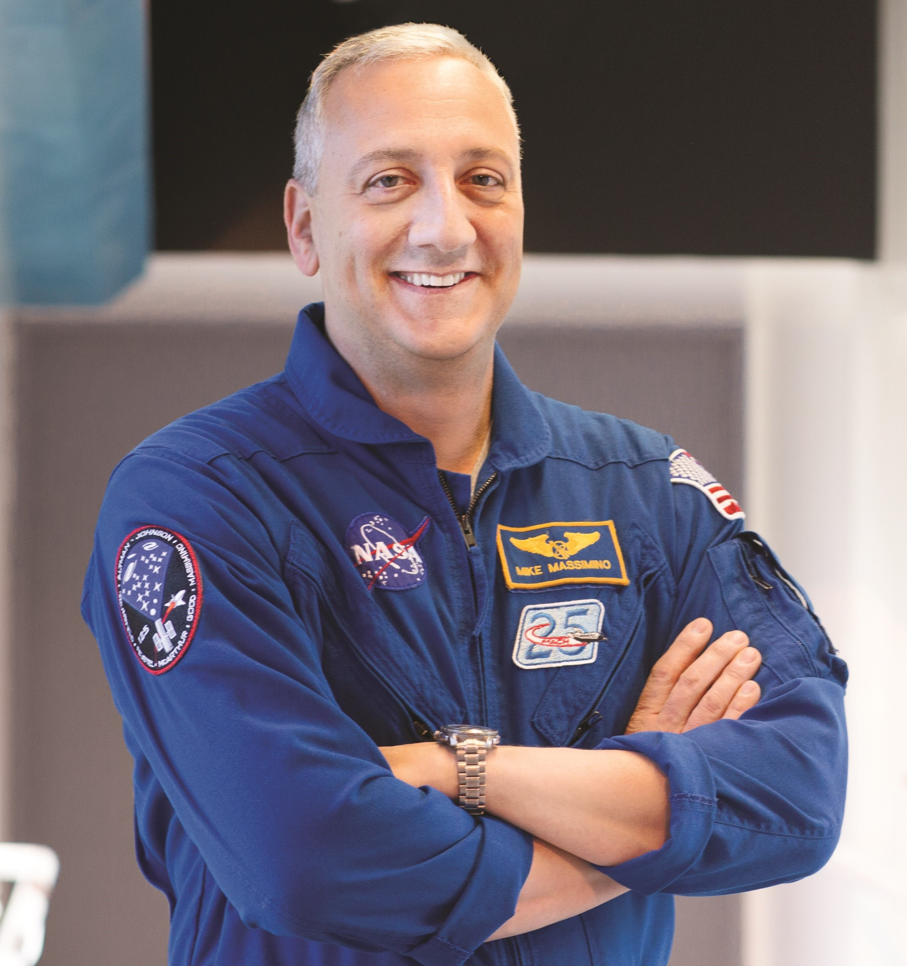
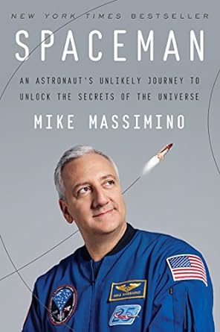
Watch Mike Massimino: The Power of Perspective
Four-time spacewalker on two missions to the Hubble Space Telescope, including the final Hubble servicing mission, which has been called the most dangerous and complex mission in space shuttle history
Professor of mechanical engineering at Columbia University and the senior advisor for space programs at the Intrepid Sea, Air & Space Museum
Set a team record for the number of hours spacewalking in a single space shuttle mission, performed the most intricate repair ever attempted in space and he was the first person to tweet from space
Received two NASA Space Flight Medals, the NASA Distinguished Service Medal, the American Astronautical Society’s Flight Achievement Award, and the Star of Italian Solidarity
Has a recurring role as himself on the hit CBS sitcom The Big Bang Theory, was featured in the IMAX film Hubble 3D and has been called “the real-life astronaut who inspired George Clooney’s role” in the film Gravity
2X author of Spaceman: The True Story of a Young Boy’s Journey to Becoming an Astronaut and the New York Times bestseller Spaceman: An Astronaut's Unlikely Journey to Unlock the Secrets of the Universe, in which readers are transported into a rare, wonderful world where the nerdiest science meets the most thrilling adventure
Keynote Categories:
Inspiring Lives
Overcoming Obstacles and Challenges
Teamwork & Personal Growth
View Mike’s Profile Page
MIKE MASSIMINO
NASA Astronaut
Fee Pending
*Client is responsible for round-trip airfare, ground transportation in event city, hotel accommodations and incidentals for up to two nights

