Slide 1
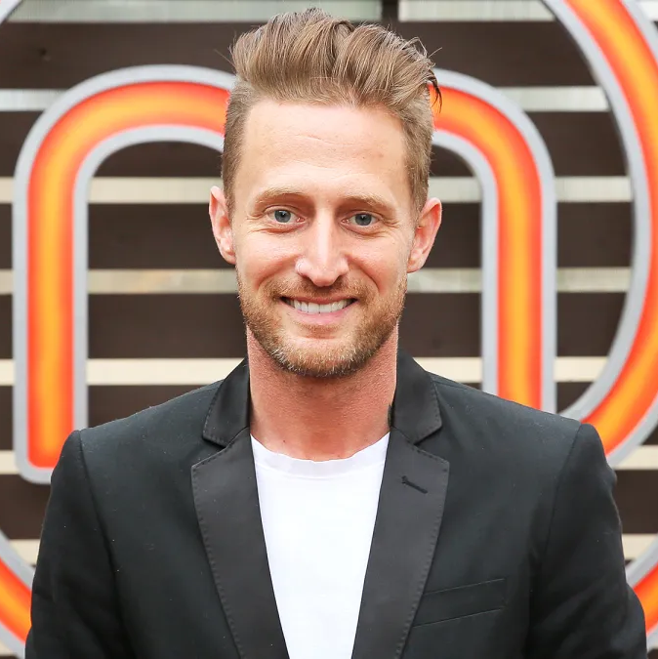


Watch Michael Voltaggio: Chef Talks About "Top Chef"
Served as Chef de Cuisine for a number of prominent southern California restaurants including The Bazaar by Jose Andres which was nominated for the James Beard Foundation Award under his leadership and The Dining Room which received the AAA Five Diamond Award, The Mobil Five-Star Award and a Michelin Star during his tenure
Opened his first restaurant ink. in West Hollywood in 2011 which was named "America's best new restaurant" by GQ Magazine the following year
Opened ink. sack, ink. well as well as Voltaggio Brothers Steak House in Maryland and Estuary in Washington D.C alongside brother Bryan
Winner of the sixth season of Top Chef on Bravo
Has competed against Bobby Flay on Iron Chef America and has judged Top Chef Canada, Guy’s Grocery Games and the new Food Network show The Julia Child Challenge
Southern California Restaurants:
STRFSH (Santa Monica, CA)
MICHAEL
VOLTAGGIO
$60,000
*Client is responsible for business class, round-trip airfare, ground transportation, hotel accommodations and incidentals for up to two nights

