Slide 1
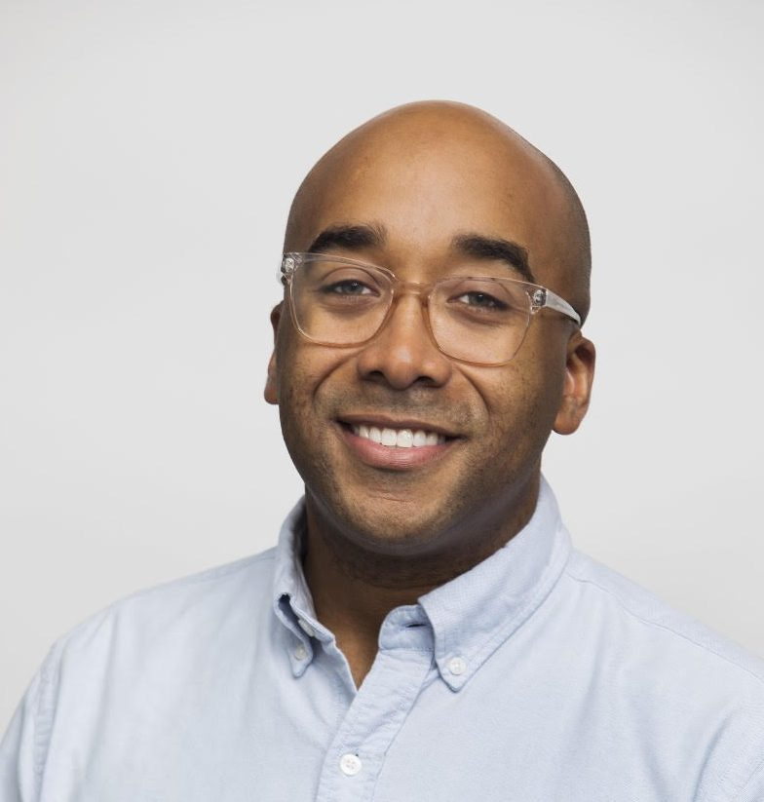
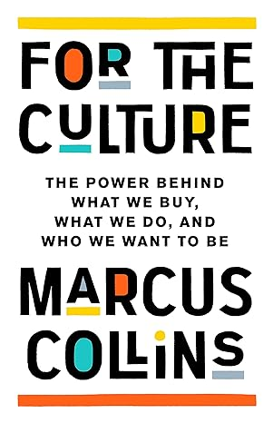
Watch Marcus Collins: TED - Marketers Don't Know People
Watch Marcus Collins: The Power of Culture in Business and Branding
Award-winning marketer and cultural translator, currently Chief Strategy Officer at award-winning agency Wieden+Kennedy and marketing professor at the Ross School of Business at the University of Michigan
Credited as the architect of some of the most famous ad campaigns of the last decade for brands including Budweiser, McDonald’s, Target, Peloton, and Google and ran digital strategy for superstar, Beyonce
Celebrated expert on cultural contagion, meaning-making, brand strategy, and consumer behavior, he shows audiences in any industry or profession how to harness the power of culture to get others to share your vision and most of all, take action.
Honors include being an AAF Advertising Hall of Achievement Inductee, 2022 Cannes Lions Jury Member, a member of the 2023 Thinkers50 Radar Class, recipient of Advertising Age’s 40 Under 40 award and Crain’s Business’ 40 Under 40 award
Author of the soon to be released book For the Culture: The Power Behind What We Buy, What We Do, and Who We Want to Be, which examines the influence of culture on consumption and unpacks how everyone from marketers to activists can leverage culture to get people to take action.
Sample Keynote Topics:
The Curious Case of Cultural Consumption
The Life of a Black Sheep
Unlocking the Power of Networks
MARCUS COLLINS
Esteemed Marketing Campaign Architect

