Slide 1
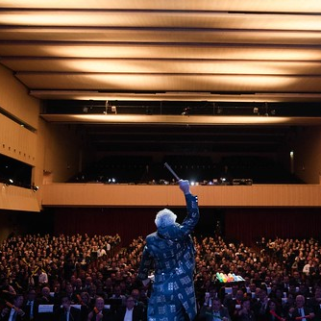
Watch All Videos for Steve Barnett:
The ability to motivate and guide individuals and organizations towards their fullest potential is a rare gift, and Steve Barnett, known as “The Silent Conductor,” is a master in this realm.
The Power of Silence: Steve Barnett understands that sometimes, it's in the moments of silence that we find the most profound inspiration. He encourages individuals to embrace stillness, allowing them to discover their inner voices and true aspirations.
Harmony through Collaboration: Just as an orchestra creates beautiful music through harmonious collaboration, so too do individuals and teams succeed by working together. Barnett emphasizes the value of cooperation and unity in achieving greatness.
Imagine the conductor not saying a thing, yet speaking volumes about leadership, communication, cooperation and synergy.
Silent Conductor is the world's premier motivational Non-Speaker. Using only simple percussion instruments, boundless energy and physical humour—and without uttering a word.
The Silent Conductor takes an audience of untrained, unrehearsed individuals and turns them into a orchestra making music in amazing harmony.
IDEAL FOR:
Team Building – Teamwork
Motivation
Entertainment
VIEW PROFILE LISTING
STEVE BARNETT
The Silent Conductor
Fee Pending
*Client is responsible for business class, round-trip airfare, ground transportation, hotel accommodations and incidentals for up to two nights

