Slide 1
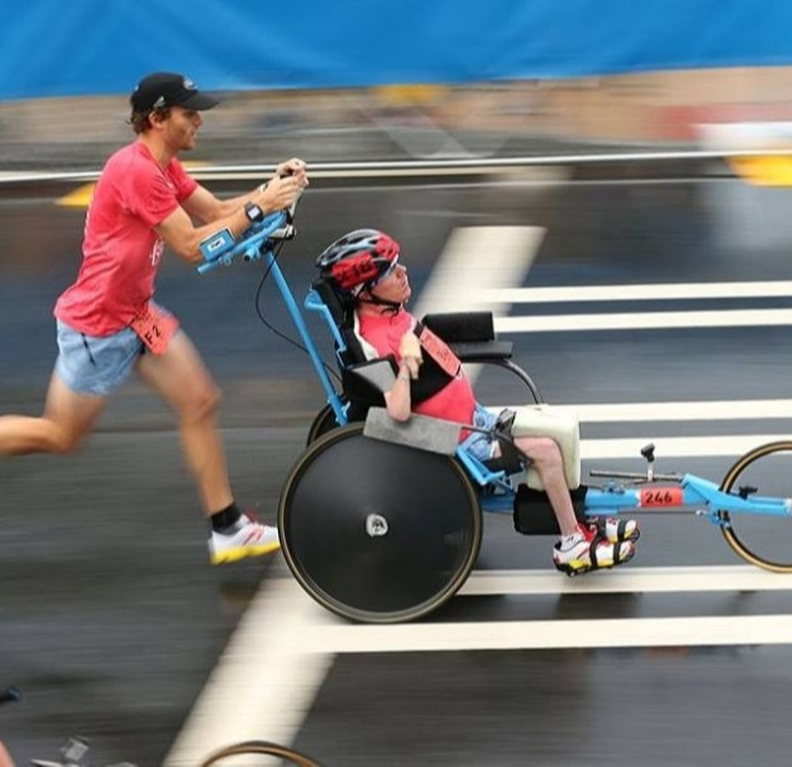
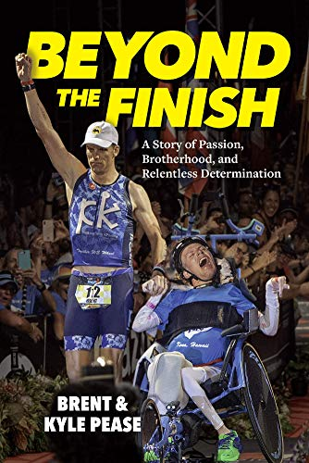
Watch Kyle & Brent Pease: What we can do!
Upon witnessing Brent complete his first IRONMAN competition, Kyle (Diagnosed with Spastic Quadriplegic Cerebral Palsy as a child asked Brent a life-changing question: ‘Can people in wheelchairs do IRONMAN?’ Brent never hesitated with his response; the answer was a resounding….. ‘YES!’
In a time of 15 hours, nine minutes and 24 seconds, the two brothers from Atlanta overcame all odds and became the first assisted bother team to become Ironmen.
Brent and Kyle speak to audiences across the nation, sharing their message of inclusion and define what is truly possible, and through their strength and tenacity audiences are inspired to stand up, face their own challenges and embrace change.
Founded The Kyle Pease Foundation; empowering athletes with disabilities to compete in the multi-sport and endurance world, by providing assistance to meet their individual needs through sports and competition.
Keynote Topics:
Find Your Finish
Together We Wheel
VIEW FULL PROFILE
Kyle & Brent Pease
Inspirational Speakers
$12,000
*Client is responsible for $2,500 travel buyout and hotel accommodations for up to (2) nights

