Slide 1
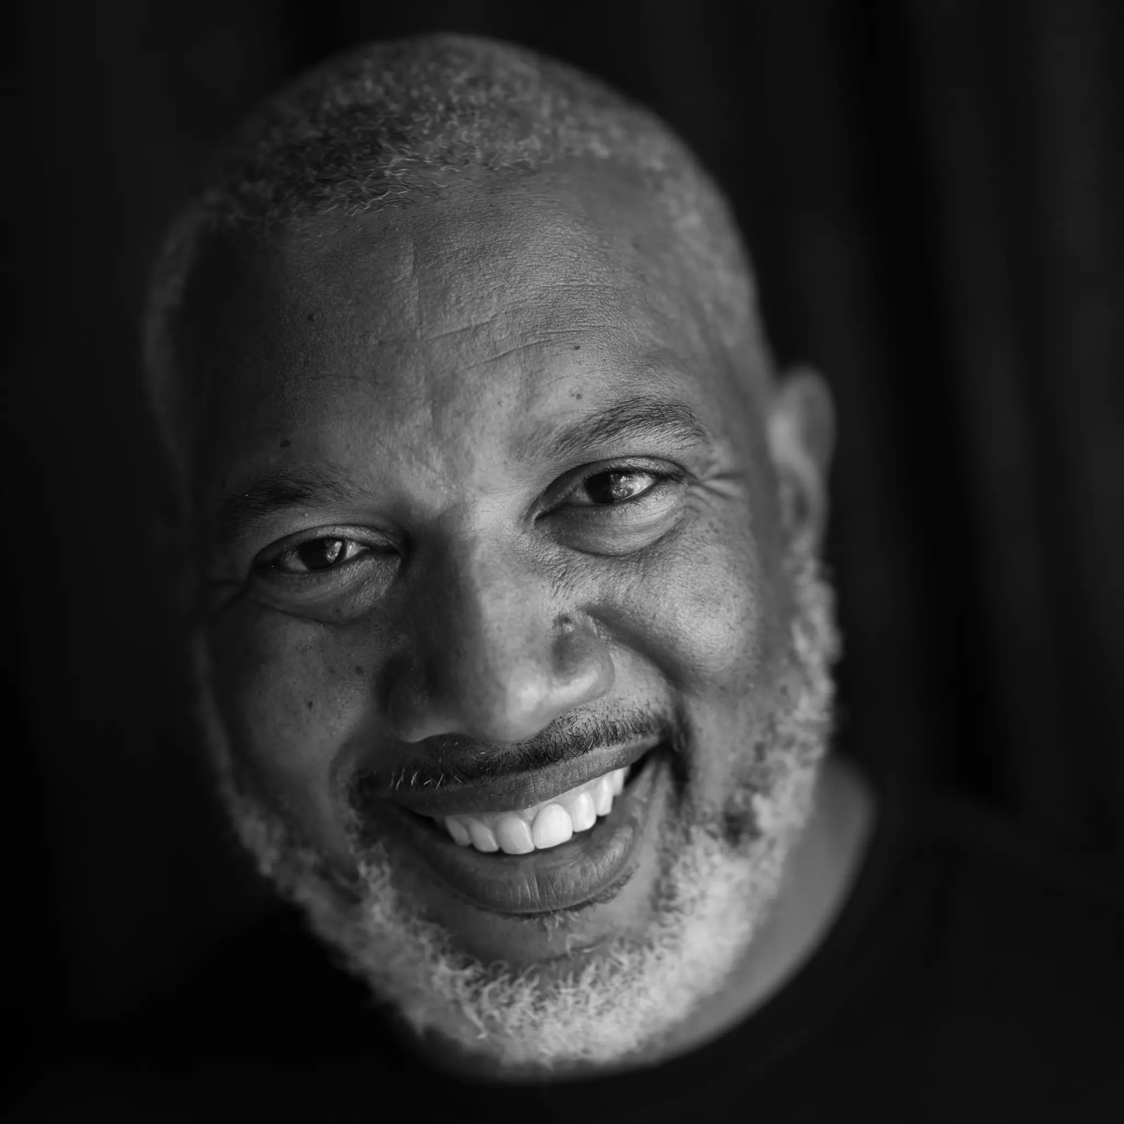
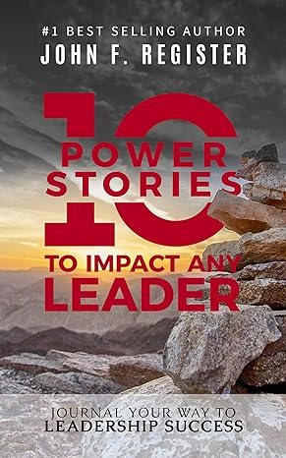
Watch John Register: Mindset to Mindsight
Watch John Register: Keynote Showreel
John Register is a two-time Paralympian, Paralympic Games Silver Medalist, Persian Gulf War veteran, and TEDx Motivational Speaker.
John teaches business professionals through his “Hurdling Adversity” speeches and podcasts to “amputate fear and embrace their new normal,” as they discover “stories within themselves.”
John Register is a former elite athlete and decorated military veteran who, despite facing a life-altering injury, has transformed his personal challenges into a powerful message of hope and empowerment.
He shares the lessons he has learned about overcoming obstacles, adapting to change, and finding new ways to achieve success.
His messages of resilience, adaptability, and inclusion resonate deeply with audiences worldwide, leaving a lasting impact and inspiring positive change in the lives of those he encounters.
KEYNOTE TOPICS:
TRANSFORM ADVERSITY INTO ADVANTAGE
CHAMPIONS MINDSET
MAXIMIZE PROFIT THROUGH DIVERSITY
HURDLING ADVERSITY
CHAMPIONS MINDSET
John Register, CSP
Inspirational Speaker
$20,000 – 25,000
*Client is responsible for ground transportation in event city, hotel accommodations and incidentals
for up to two nights

