Slide 1
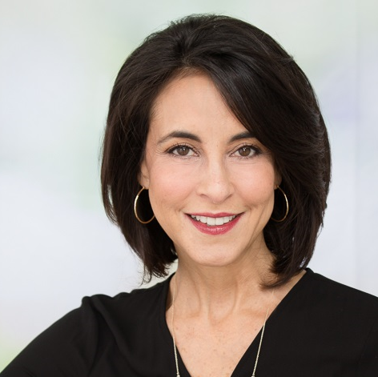
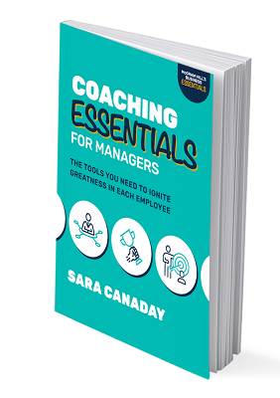
Watch Sara Canaday: SXSW
Watch Sara Canaday: Showreel
Sara Canaday is a recognized expert and author in leadership and career management who helps arm professionals with the strategies and practices they need to succeed in today’s complex and competitive business climate.
She recognized instead that career advancement was much more closely linked with how people applied their knowledge and talents — their capacity to collaborate, communicate, and influence others.
As a keynote speaker, award winning author, and executive coach, Sara has a unique gift for connecting and communicating with her audiences to propel them from light-bulb-moment insight to strategic change.
At the core of Sara’s message lies the belief that leadership is a journey of continuous growth and self-awareness.
Through her speaking engagements, she guides audiences toward discovering their unique leadership strengths and areas for improvement. Journal, Entrepreneur and Forbes.
Keynote Topics:
Leadership Unchained: Defy Conventional Wisdom for Breakthrough Performance
How to Lead in our Fast-Isn’t-Fast Enough World
SARA CANADAY
Leadership Development
$20,000
*Client is responsible for ground transportation in event city, hotel accommodations and incidentals
for up to two nights

