Slide 1
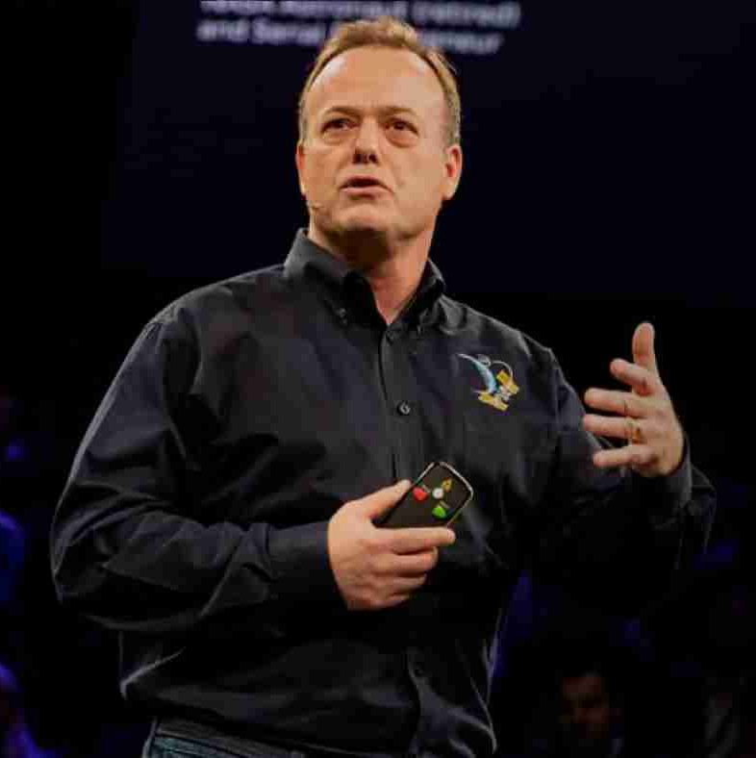
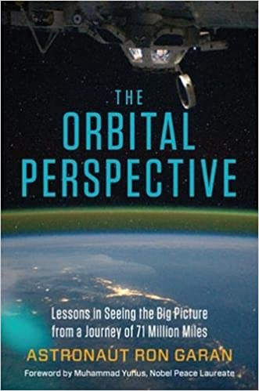
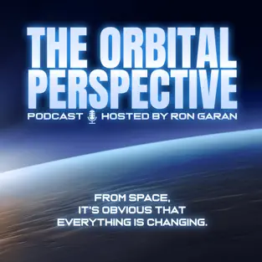
Watch Ron Garan: Floating in Darkness
Watch Ron Garan: Speaker Showreel
Former NASA astronaut and highly decorated combat fighter Ron Garan racked up 178 days in space and more than 71 million miles in 2,842 orbits during tours on the International Space Station after launching to space aboard the US Space Shuttle and Russian Soyuz spacecraft.
Ron Garan has been a member of several high-performing teams in combat, during high-risk test flights, and in dealing with life-or-death aircraft emergencies—which have forged a process to turn stress into performance.
Ron Garan merges those lessons with his entrepreneurial and corporate executive experience, providing unique insights for organizations facing tough challenges.
The idea of strapping yourself to a rocket filled with 4 million pounds of explosives forces one to learn and accept new technology.
We can take an environmentally sustainable business approach while developing new and exciting products and services, creating more jobs, and increasing profitability.
Key Takeaways:
Highly engaging and inspiring, Ron Garan uses the International Space Station and many other examples of profound collaboration to drive home the incredible power of being able to set aside our differences and work together toward a shared goal.
Most Popular Keynote Topics
Leadership & Risk Management
Finding Unity in Divisive Times
Embracing Change & Technology
RON GARAN
Former NASA Astronaut | Inspirational Speaker
Fee Pending
*Client is responsible for round-trip airfare, ground transportation in event city, hotel accommodations and incidentals for up to two nights

