Slide 1
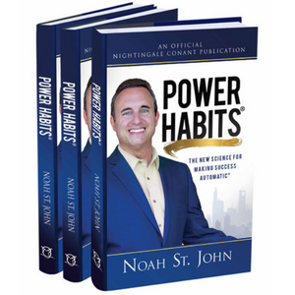
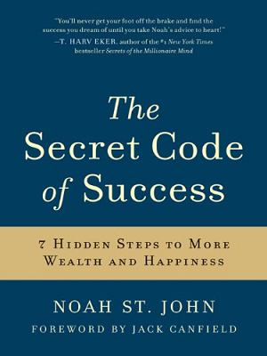
Watch Noah St. John: Best Motivational Speeches
Watch Noah St. John: How to choose a speaker
​
Noah’s mission is to eliminate not-enoughness from the world and he is internationally recognized for his signature coaching services; facilitating workshops at companies and institutions across the globe.
Noah is the ONLY author in history to have works published by HarperCollins, Hay House, Simon & Schuster, Mindvalley, Nightingale-Conant, and the Chicken Soup for the Soul publisher.
Working with Hollywood celebrities, 8-figure company CEOs, professional athletes, top executives and entrepreneurs, Noah’s coaching clients have added more than $2.7 Billion dollars in sales
From ABC and NBC to CBS and Fox, Noah St. John's influence as a motivational speaker is truly remarkable.
Keynote Topics:
THE POWER HABITS® FOR ULTIMATE SUCCESS
THE POWER HABITS® OF LEGENDARY LEADERSHIP
THE POWER HABITS® TO SUPERCHARGE SALES
NOAH ST. JOHN
Motivational Speaker
$25,000
*Client is responsible for ground transportation in event city, hotel accommodations and incidentals
for up to two nights

