Slide 1
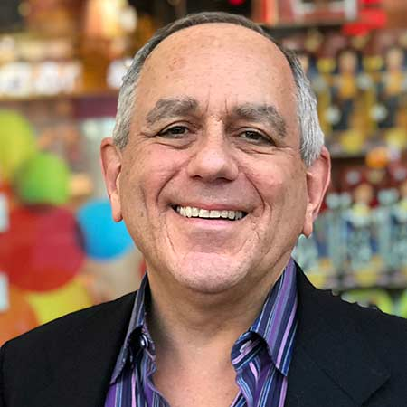
Watch Michael Solomons: 2019 Reel
A thought leader in marketing and advertising, Michael Solomon presentations reveal cutting-edge trends in advertising and marketing, branding, consumer behavior, and social media.
He creates a visual excursion into the minds of consumers and what influences them to buy. He captivates audiences with the insights he unveils during his interactive keynotes and seminars.
Michael Solomon speaks about cutting-edge approaches to sales and consumer psychology including gamification, customer journey mapping and sentiment analysis.
Michael Solomon exposes what drives consumer subcultures like Millennials, Baby Boomers, women, and the multicultural market.
Michael Solomon customizes every presentation, tailoring programs to be relevant for each audience. He incorporates content provided by the sponsor and actively researches each speech with the goal of exceeding expectations.
KEYNOTE TOPICS:
Profit from Disruption
The Many Faces of AI
INNOVATIVE MARKETING MASTERY™
Developing a Gender Balanced Business
Why can’t you be more like me?
Michael Solomon
Consumer Behavior Expert
Fee Pending
*Client is responsible for roundtrip airfare, ground transportation, hotel accommodations and incidentals for up to two nights

