Slide 1
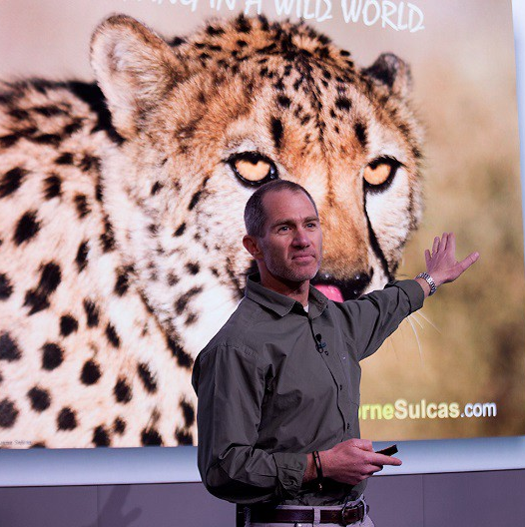
Watch Lorne Sulcas: The Big Cat Guy
Lorne Sulcas – The Big Cat Guy is unorthodox. Definitely not your average motivational speaker.
Lorne Sulcas has been ‘WOW’ing’ and transforming top teams and organizations around the world with his unique Thriving in a Wild World™
For nearly a decade, Lorne was a game ranger, tracking and photographing Africa’s Big Cats on a daily basis.
Lorne travels the world sharing potent life and organizational lessons from these super-predators that have been thriving for millennia in the face of change and competition.
Key Takeaways:
He is an extraordinary expert; renowned professional; a ‘cat’-alyst; trusted Motivational and Conference Keynote Speaker to CEO’s and Event Planners. Around the planet.
Sample Keynote Topics:
Thriving in a Wild World™
Change
Teamwork
LORNE SULCAS
The Big Cat Guy
Fee Pending
*Client is responsible for round-trip airfare, ground transportation in event city, hotel accommodations and incidentals for up to two nights

