Slide 1
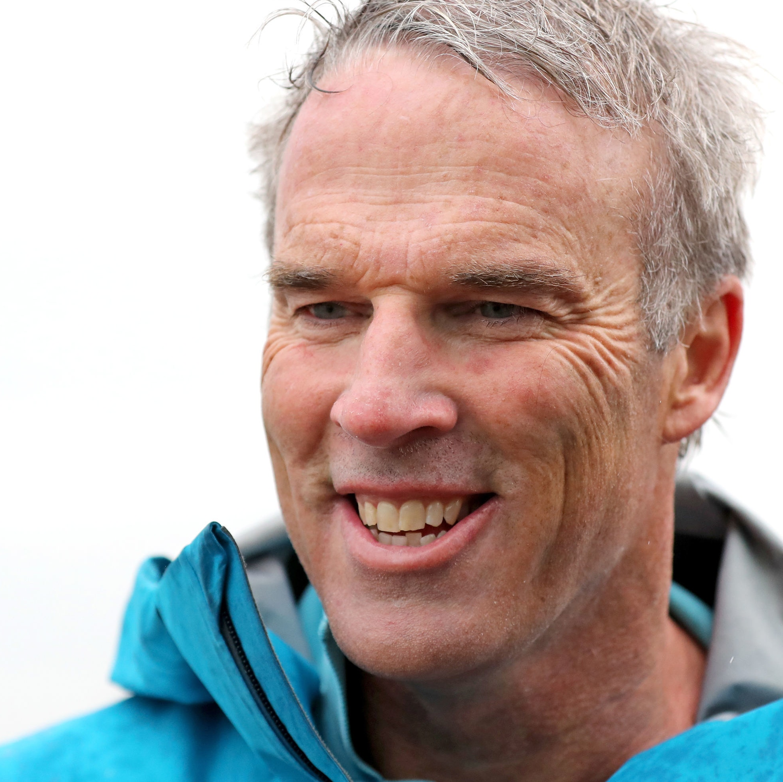
Watch Lewis Pugh: Virtual Interview with Goldman Sachs
Endurance swimmer, a maritime lawyer and the UN Patron of the Oceans who pioneers swims in the most vulnerable ecosystems on Earth to call for their protection
First person to complete a long-distance swim in every ocean of the world and was also the first to swim across the North Pole, and the first to swim the length of the English Channel
Instrumental in protecting over 2 million kilometers of vulnerable ocean, and aspires to continue this work with a goal of protecting 30% of the world’s oceans
Appointed as the UN Patron of the Oceans by the United Nations
Awarded South Africa’s highest honor, the Order of Ikhamanga (Gold Class), Named a Young Global Leader by The World Economic Forum, and was named Adventurer of the Year by National Geographic
Inducted into both the International Marathon Swimming Hall of Fame and the Ice Swimming Hall of Fame
Author of two books, Achieving the Impossible and 21 Yaks and a Speedo, both of which were bestsellers
Sample Keynote Topics:
Achieving the Impossible
Leading Diverse Teams
Managing Change
Lewis Pugh
Extreme Swimmer & Ocean Advocate
$48,000
*Client is responsible for ground transportation in event city, hotel accommodations and incidentals
for up to two nights

