Slide 1
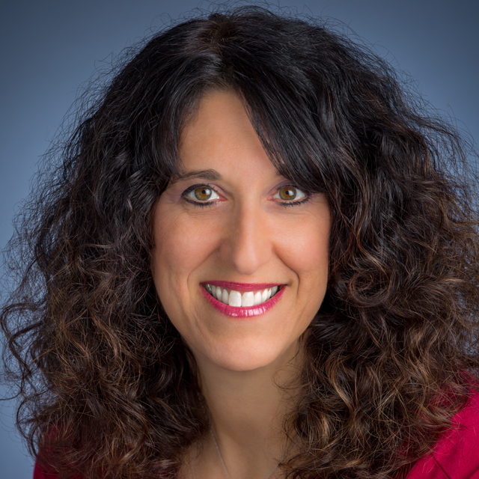
Watch Juli Shulem: Life Productivity
Watch Juli Shulem: How to get started
Juli Shulem provide coaching services around stress, anxiety, and frustration reduction because people come to me stating they were profoundly overwhelmed.
Juli has a Master’s of Science degree in Industrial Organizational Psychology (IOP) in order to work with companies and affect the dynamics of leaders and team productivity
Juli Shulem brings energy and passion to the conference stage, or office environment, in order to inspire and motivate those I am helping to educate.
Key Takeaways:
Now, imagine you have a person, who is vested in YOUR business success, who knows what your company is about, what drives you forward, and knows where you want to go.
Most Popular Keynote Topics
"Handling ADHD in the workplace – You’ve got this!“
“Productivity Despite Distractions”
"You've got Mail....and Mail...and Mail“
“Don’t Waste Your Time! No Really, Stop That!”
“Balance is like the Perfect Tango“
“Simplify. Your Life Depends On It
Juli Shulem
Organizational Expert
Fee Pending
*Client is responsible for round-trip airfare, ground transportation in event city, hotel accommodations and incidentals for up to two nights

