Slide 1
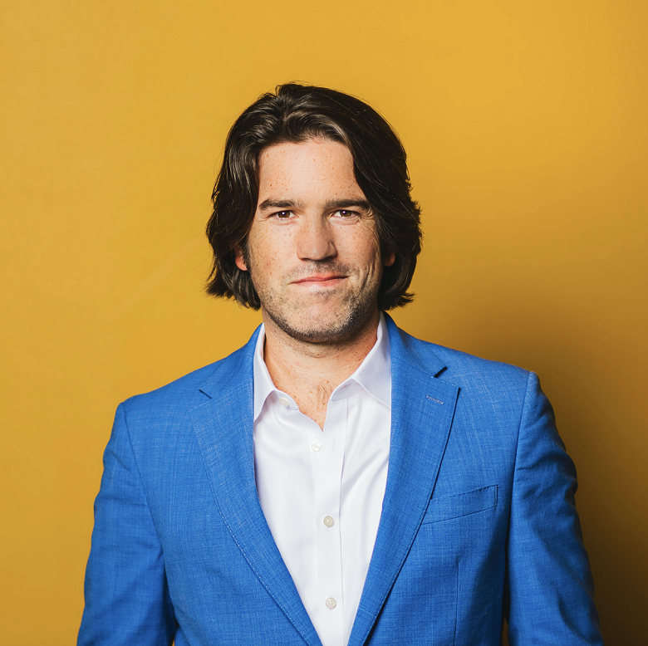
Watch Joshua M. Evans: Purpose Drives People
Joshua M Evans has built his career around the mission to provide leaders and teams with the tools to find their purpose and passion for the work they do.
For over 15 years, Joshua M Evans worked in corporate America for companies of all sizes from 30 people to 60,000. He believes that for an organization to succeed, they need to know that attitude is far more important than aptitude.
Joshua M. Evans is on a quest to fundamentally change the way people view their work by bringing deeper purpose into the workplace. Joshua uniquely combines his life experiences and corporate knowledge to craft immersive moments with all audiences.
Joshua M Evans quickly became aware that his positive attitude and authentic interactions with people were rare and welcome commodities in the companies who hired him.
Journal, Entrepreneur and Forbes.
Keynote Topics:
Purpose or Perish
Change Engage Evolve
Rediscover purpose and fulfillment in your work.
Build Phenomenal Culture with Engaged Team Members.
Culture of Engagement
Joshua M. Evans
Employee Engagement & Culture Specialist
$15,000
*Client is responsible for ground transportation in event city, hotel accommodations and incidentals
for up to two nights

