Slide 1
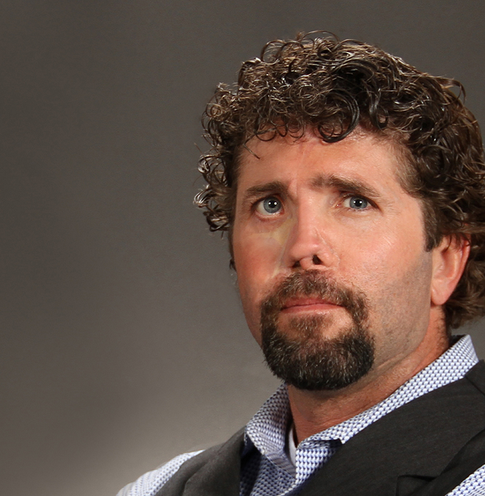
Watch Jason Redman: What is the pointman planner?
Watch Jason Redman: 3 minutes of Motivation
Jason Redman puts his vast experience and expertise to work as speaker, coach, author and trainer, helping individuals, teams and organizations of all types and sizes to define and implement lasting change, even in the wake or face of failure, crisis and adversity.
“These are not SEAL lessons; these are human lessons!” Your team will walk away with a new perspective and understanding that there are no bad days, only good days and great days
Despite being shot twice in the arm and once in the face, as well as enduring multiple rounds to his helmet, night-vision goggles, body armor and weapon, Jason Redman fought valiantly with his team. They won the fight while ensuring that the entire team returned home alive.
Jason Redman has done an incredible job of taking these lessons learned and making them relatable to teams, businesses and organizations around the world.
Key Takeaways:
Retired Navy SEAL Lieutenant Jason Redman electrifies audiences with his high-energy presentations on leadership, failure, redemption, catastrophic injury and his breathtaking journey to “overcome all” in the aftermath of wartime enemy ambush and in the face of what he calls life ambushes during the years that followed.
Keynote Topics:
Get off the X and LEARN to LEAD
Pointman for Life
Six Tenets of Success
Five Principles of Elite Performance
Will You Be Ready?
The Trident: The Forging and Reforging of a Navy SEAL
Jason Redman
Former Navy Seal Commander &
Leader Speaker
Fee Pending
*Client is responsible for round-trip airfare, ground transportation in event city, hotel accommodations and incidentals for up to two nights

