Slide 1
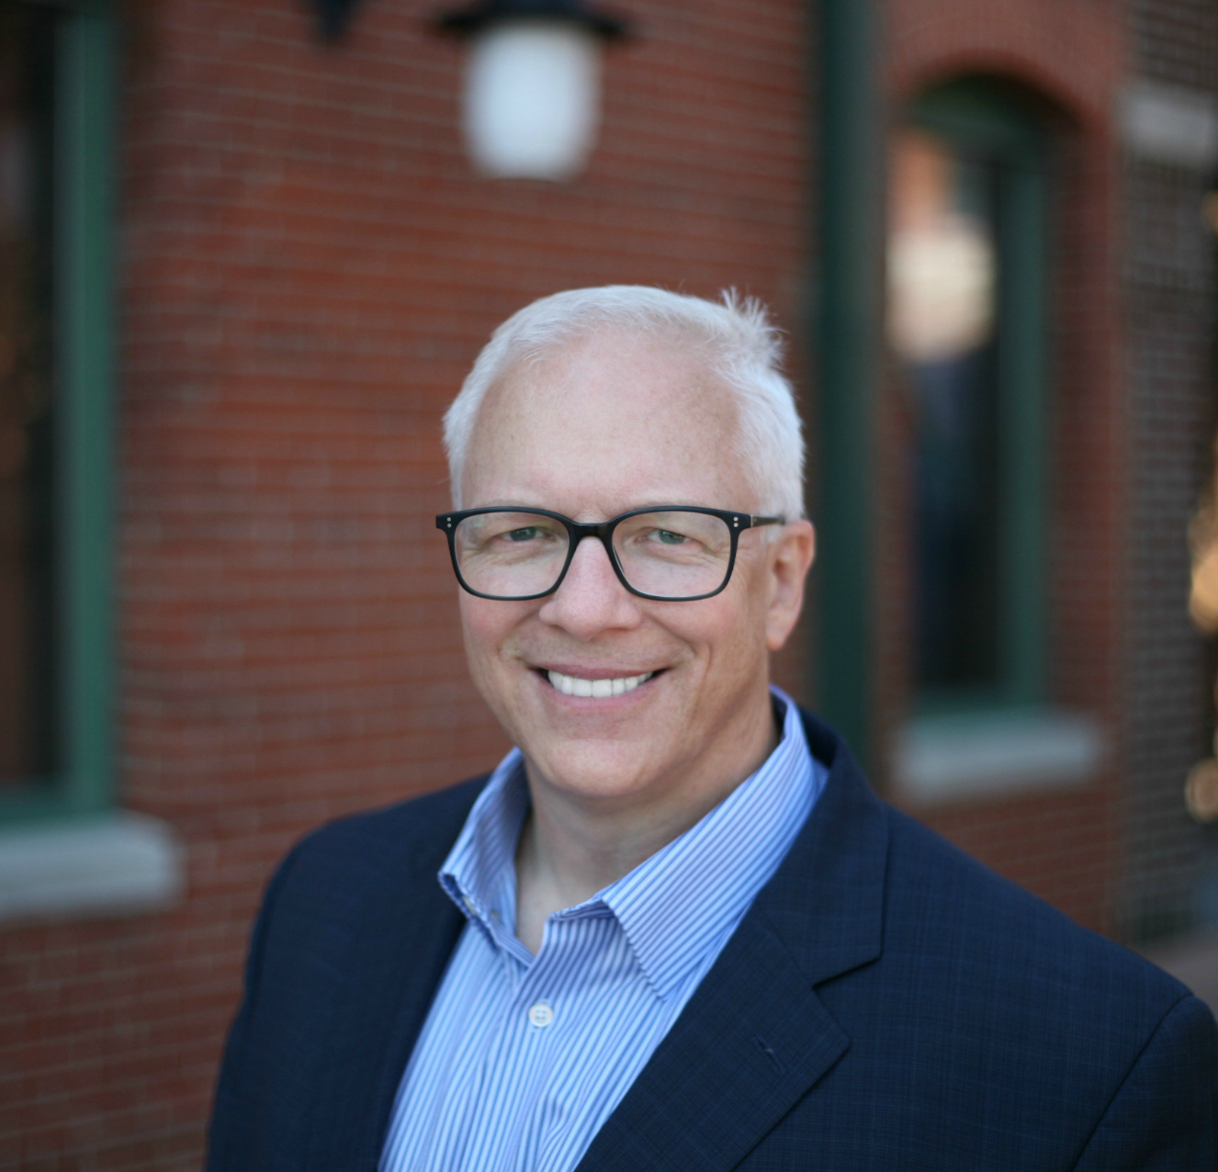
Watch Ford Saeks: Speaker Showreel
Watch Ford Saeks: Introduction
Ford Saeks has redefined the formula for business success. His efforts have helped companies generate a total of over a billion dollars in sales worldwide.
With over 20 years’ experience (ranging from retail to wholesale), he has founded over ten companies, authored four books, secured three U.S. patents, and received numerous industry awards.
From grassroots to Google, Ford Saeks provides his clients with fresh perspectives and doable tactics to resolve marketing, operations, and growth challenges.
Quick-witted and highly engaging, Ford Saeks – Business Strategy is a nationally accredited speaker that hits the stage with immediate charisma and insider tools that consistently garner rave reviews.
It’s like listening to your best friend that already trained for the race, experienced the mishaps, and is back to show you how to win it.
There is no “one-size fits all” business formula but, you can rest easy knowing that Ford is a sure fit to maximizing your business success.
KEYNOTE TOPICS:
BUSINESS GROWTH ACCELERATION
INNOVATIVE MARKETING MASTERY™
Developing a Gender Balanced Business
Why can’t you be more like me?
Ford Saeks
Business Strategy Expert
Fee Pending
*Client is responsible for roundtrip airfare, ground transportation, hotel accommodations and incidentals for up to two nights

