Slide 1
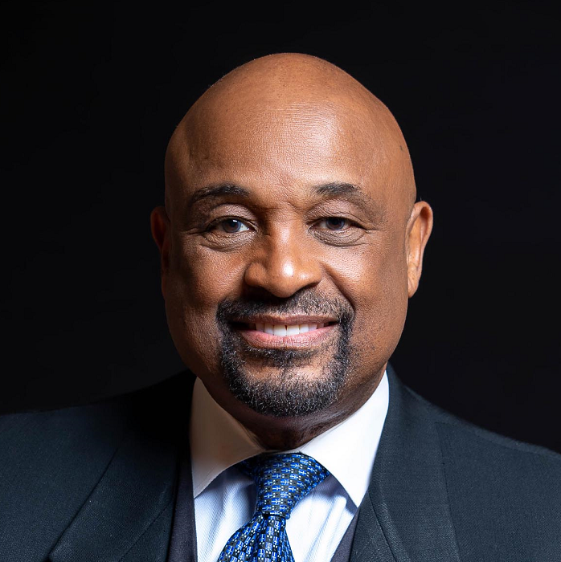
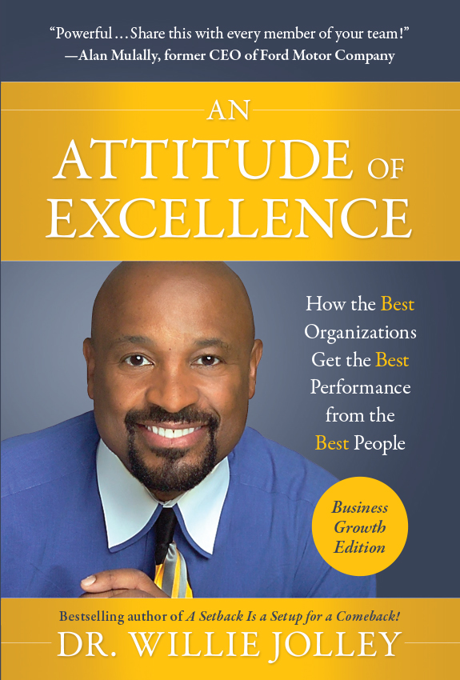
Watch Dr. Willie Jolley: The will to win
Watch Dr. Willie Jolley: Sizzle Reel
There are many motivational speakers, and then there is the one, the only, the incomparable Dr. Willie Jolley. He truly is a renaissance man!
He’s a triple threat personality and a global thought leader. He is a Hall of Fame speaker, an award-winning singer and a popular national radio and television personality.
He has gone on to be named “One of the Outstanding Five Speakers in the World” and “Motivational & Inspirational Speaker of The Year”
Dr. Willie Jolley keeps it moving with high energy and enthusiasm. He delivers powerful nuggets on how every person can live a better life and win more, every day!
Key Takeaways:
Dr. Willie Jolley uses his public platform to pursue his mission of empowering and encouraging people to rise above their circumstances and maximize their God-given potential!
Sample Keynote Topics:
Achieve More with an Attitude of Excellence
Turn Your Setbacks into Comebacks…then Turn Your Comebacks Into Greenbacks!
Change Is Good…When Your Attitude is GREAT!
DR. WILLIE JOLLEY
Motivational Speaker
Fee Pending
*Client is responsible for round-trip airfare, ground transportation in event city, hotel accommodations and incidentals for up to two nights

