Slide 1
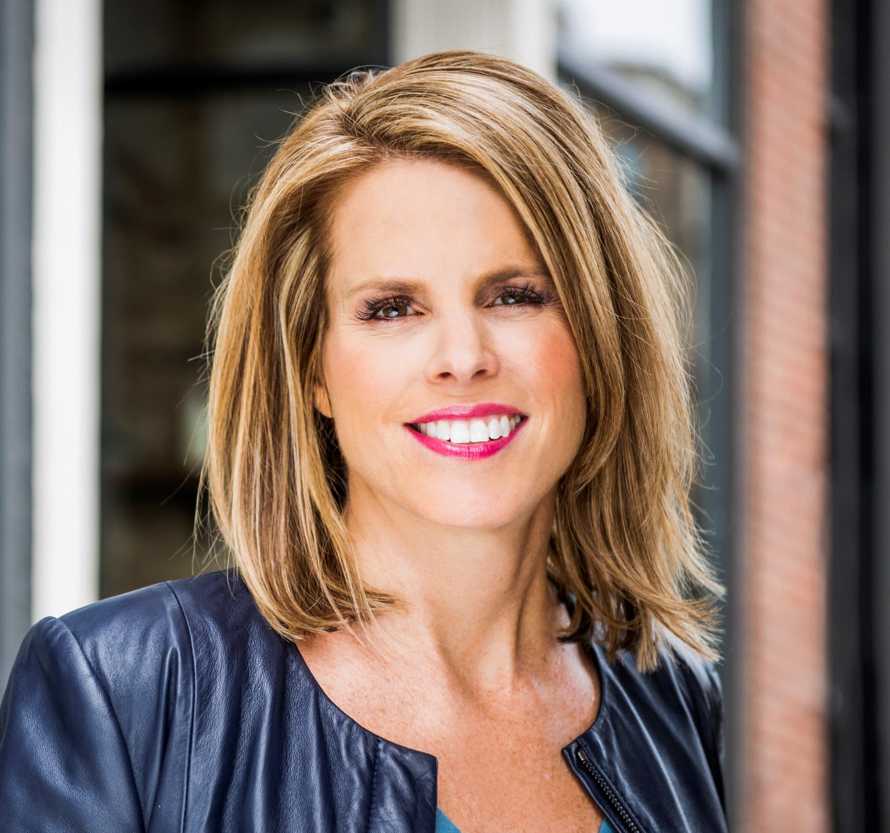
Watch Dr. Elizabeth Lombardo: Showreel
Watch Dr. Elizabeth Lombardo: Science of Happiness
Dr. Elizabeth Lombardo is the authority on how to crush your inner critic so that you can live a life of purpose, fulfillment and True Success™.
She’s America’s most trusted celebrity psychologist with over 100 national media interviews including The Today Show, Good Morning America, Dr. Oz, Fox Business News, The Wall Street Journal, Forbes, and countless others.
Dr. E is on a mission to change the global conversation around ICS (Inner Critic Syndrome) FOR GOOD… so we can all live happier, fuller and more connected lives.
Dr. Elizabeth Lombardo brings an unparalleled energy to stages around the globe by actively engaging audiences.
Described as an example of perseverance and being unstoppable despite life’s
Key Takeaways:
Harvard research shows that happier employees experience a 31% increase in productivity, a 37% increase in sales and 15 less sick days/year. The beauty is that happiness is a skill that can be learned with this powerful training.
Keynote Topics:
Leadership from the Inside Out
Creating a Culture that Embraces and Thrives from Inclusion
Three (3) vital ingredients needed to create an inclusive culture.
Dr. Elizabeth Lombardo
Celebrity Happiness Speaker
Fee Pending
*Client is responsible for roundtrip airfare, ground transportation, hotel accommodations and incidentals for up to two nights

