Slide 1
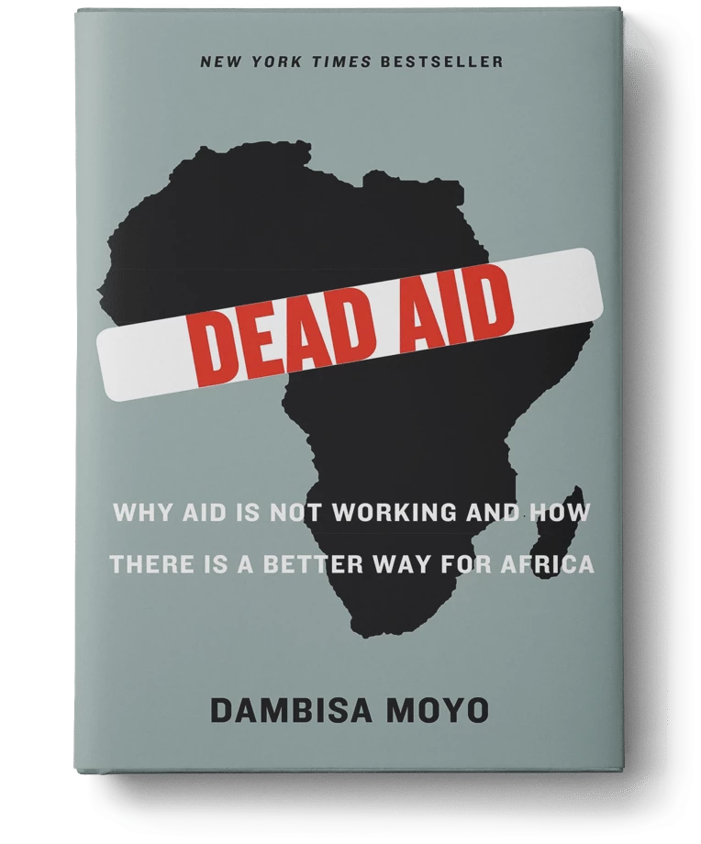
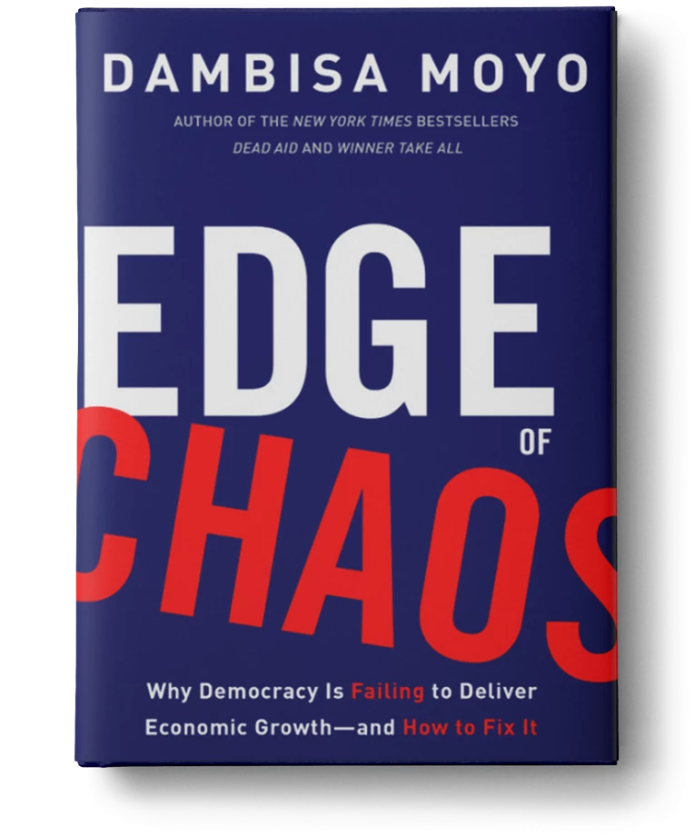
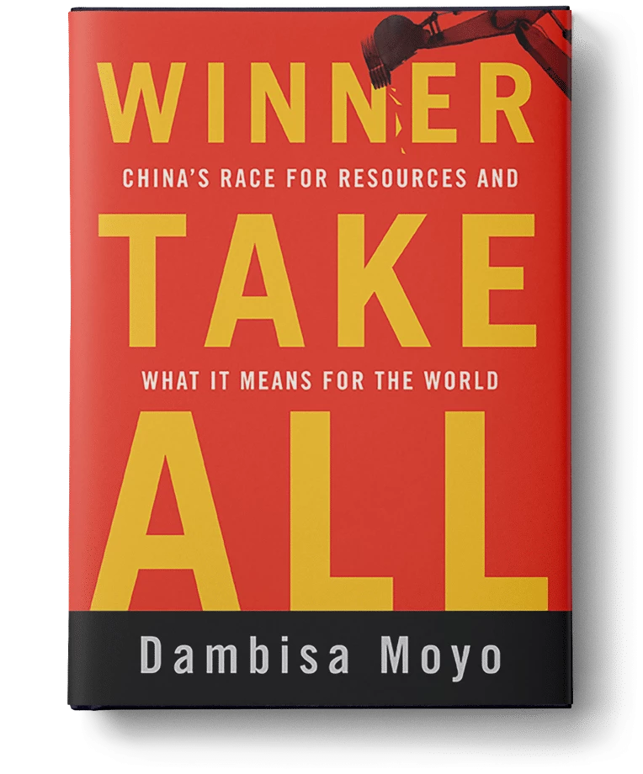
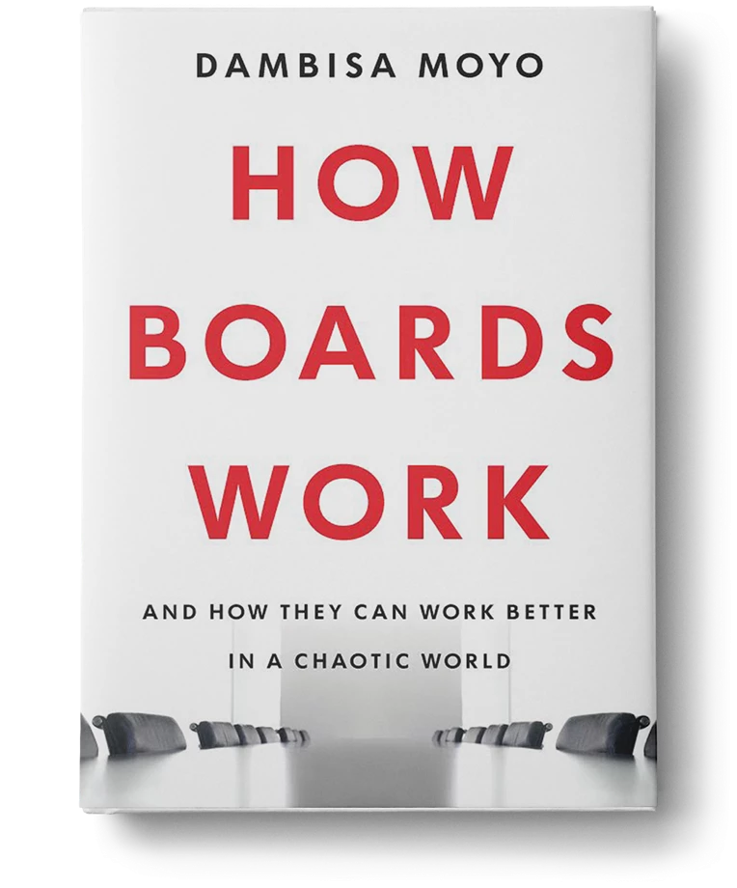
Watch Dambisa Moyo: The Trouble with Democracy
A pre-eminent thinker, who influences key-decision makers in strategic investment and public policy and is respected for her unique perspectives, her balance of contrarian thinking with measured judgement, and her ability to turn economic insight into investible ideas
Co-principal of Versaca Investments – a family office, focused on growth investing globally
Served on a number of global corporate boards including 3M Corporation, Chevron and Conde Nast
Author of 5 books, 4 of which are New York Times best sellers and her most recent, How Boards Work And How They Can Work Better in a Chaotic World ranked #5 on the Wall Street Journal best business book list in 2021
Named to the list of Time Magazine’s 100 Most Influential People in the World and has published in the Financial Times, WSJ and Harvard Business Review
Sample Keynote Topics:
Global Shifts in Economics
Politics & Business: What’s It Going To Take To Be Successful?
Emerging, Frontier and Global Markets: Investments and the Shape of the Future
DR. DAMBISA MOYO
Global Economist
Fee Pending
*Client is responsible for ground transportation in event city, hotel accommodations and incidentals
for up to two nights

