Slide 1
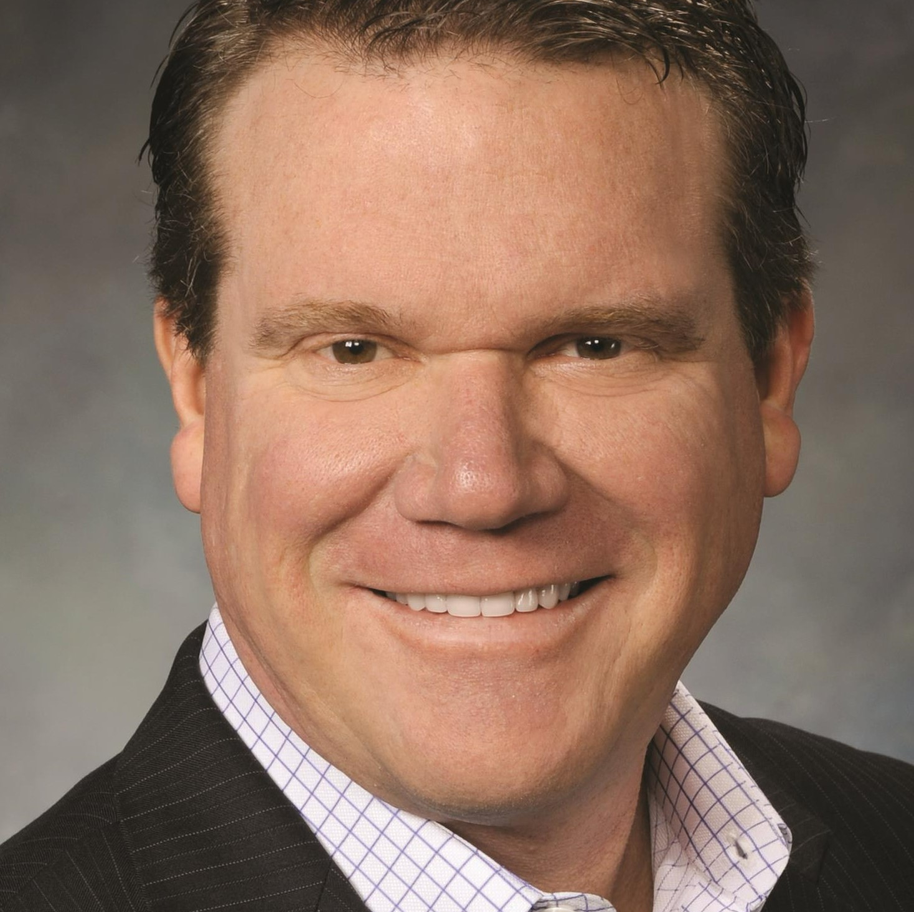
Watch Doug Dvorak: Hallof Fame Speaker
Watch Doug Dvorak: Sales Excellence
Doug Dvorak is one of the most well-traveled keynote motivational speakers available today. Doug has earned his spot in the motivational speaking hall of fame. He has also been inducted into the International Who’s Who of Professional Speaking.
Doug dedicates hours of research to each of his presentations. This dedication allows him to craft personal messages that foster real connections and atmospheres where audience members are able to learn and grow.
Doug Dvorak does not just talk about “PMA”—Positive Mental Attitude—Doug lives it.
A fun and funny educational experience. Participants will acquire humor coping skills to incorporate into their personal & professional lives.
Turn your organizations creative potential into a thriving culture of innovation. In a business world that constantly changes, innovators & problem solvers rise to the top.
KEYNOTE TOPICS:
Lighten Up
Everything Starts & Stops with Motivation
Laughter is the Best Medicine
Website Link:
Doug Dvorak
Motivational Leadership
Fee Pending
*Client is responsible for ground transportation in event city, hotel accommodations and incidentals
for up to two nights

