Slide 1
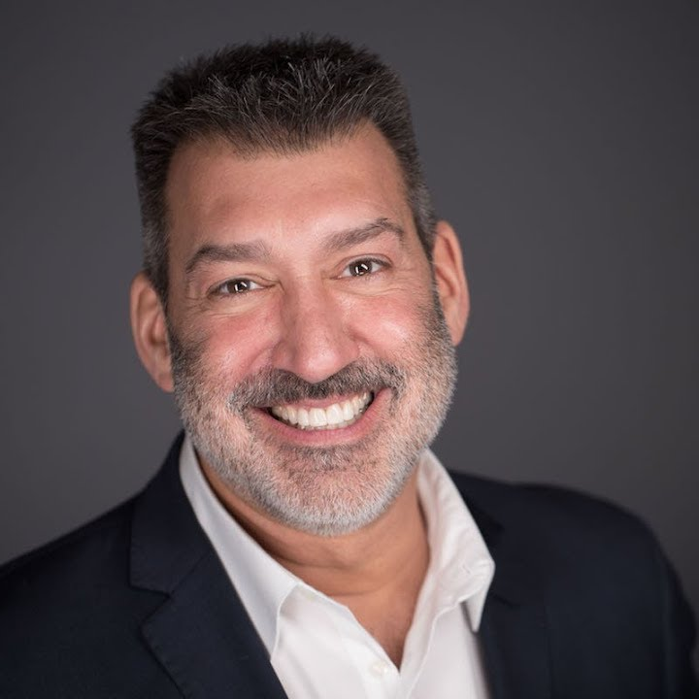
Watch David Avrin: Customer Experience 2023
Watch David Avrin: Your Customers Are Changing. Are You?
One of the most in-demand Customer Experience speakers and consultants in the world today who has shared his content-rich, entertaining and actionable presentations across North America and 24 other countries
Content focuses on helping organizations better understand and connect with their changing customers and clients to help future-proof their businesses
Author of five books including the acclaimed: It's Not Who You Know, It's Who Knows You!, Why Customers Leave (and How to Win Them Back) which was named by Forbes as “one of the 7 business books entrepreneurs need to read”
Offer a revealing look at our changing world, and how your customers are changing along with-it helping companies to better align strategies and messaging with the preferences of their customers
Former CEO group leader, and executive coach with the world’s largest chief executive organization, he has worked with thousands of CEOs and business leaders on their business brand, customer experience and competitive advantages
Key Takeaways
How to reject “going low” and mirroring some of the worst business behavior
How Disruption is touching all of your customers — even if your industry has yet to be significantly impacted
Why your customers and clients have become more demanding and impatient, and how you can meet their needs better than your competitors
Sample Keynote Topics:
Ridiculously Easy to Do Business With!
It’s not who you know, it’s who knows you!
It’s Not Who You Know, It’s Who Knows You
DAVID AVRIN
Customer Experience Expert
Fee Pending
*Client is responsible for ground transportation in event city, hotel accommodations and incidentals
for up to two nights

