Slide 1
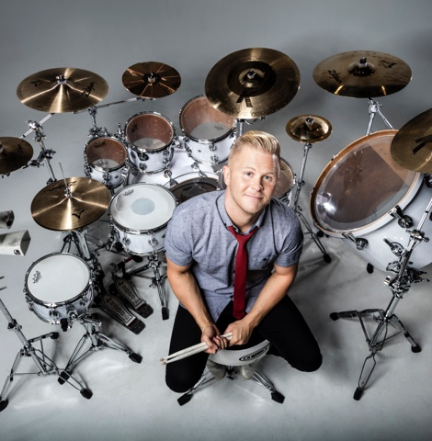
Watch Clint Pulver: Keynote Showreel
Watch Clint Pulver: CEO Feedback
Clint Pulver is the high-energy keynote speaker for today’s audiences. He is a mesmerizing blend of Motivational Keynote Speaker, Musician, Comedian, Emmy Award-winner and Leading Authority on Employee Retention.
Every year, Clint travels the globe as the UNDERCOVER MILLENNIAL speaking to hundreds of organizations with his high-energy performance and rock-the-house keynotes, tailored to every audience.
Clint helps organizations retain, engage, and inspire their team members from the front desk to the board rooms and everyone in between.
His mantra? “It’s not about being the best in the world…it's about being the best FOR the world.”
Take Aways:
Utilizing his experience as a professional drummer for more than two decades, Clint helps orchestrate your team to success through the power of music by creating a high-energy, interactive, hands-on drumming experience that allows your audience to achieve unity and a renewed sense of loyalty and trust.
Keynote Topics:
“MENTORSHIP VS MANAGEMENT”
"UNITED WE STAND”
Clint Pulver
Motivational Entertainer
Fee: Pending
*Client is responsible for round-trip airfare, ground transportation in event city, hotel accommodations and incidentals for up to two nights

