Slide 1
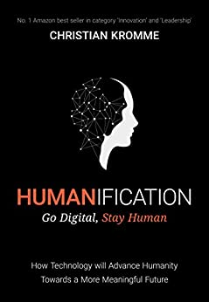
Watch Christian Kromme: Keynote Talk
Watch Christian Kromme: Around the world in 80 talks
Christian Kromme was an innovative tech-entrepreneur for 15 years until he discovered the DNA behind disruptive innovation and how to use this to predict the next big wave of technological disruption.
Christian Kromme is one of the most in-demand futurist keynote speakers, speaking in front of tens of thousands of entrepreneurs, business leaders and policymakers about the radical impact of disruptive technologies on humans and organisations.
Beside speaking Christian Kromme holds a position as a board member at the Workforce Institute EMEA, The Human Genome Foundation and some tech startups.
Christian Kromme challenges organizations to think and act like a surfer and thus helps to transform disruptive threats into disruptive opportunities.
Key Takeaways:
Our world is changing at an exponential rate! A big tidal wave of digital disruption is coming at us fast. Many organizations experience this wave as a threat and fear them, but there are also organizations that just see this wave as an opportunity.
Keynote Topics:
Humanification - Go Digital, Stay Human
The Future of Work
Future of Artificial Intelligence
Christian Kromme
Digital Innovation Futurist
$25,000
*Client is responsible for roundtrip airfare, ground transportation, hotel accommodations and incidentals for up to two nights

