Slide 1
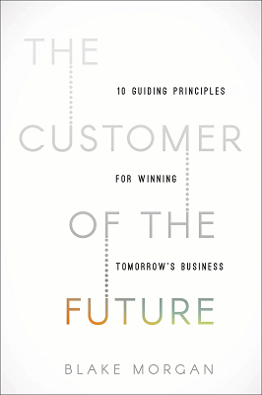
Watch Blake Morgan: Speaker Reel
Watch Blake Morgan: Create Incredible Customer Experiences
Customer experience futurist that has a vision for how technology can create a more beautiful and customer-centric world
Author of two books on customer experience, including the bestselling The Customer Of The Future: 10 Guiding Principles For Winning Tomorrow’s Business, identified by Business Insider as one of the top 20 books executives are reading to deal with COVID-19
Named one of the top 40 female keynote speakers for 2020 by Real Leaders Magazine, called “the Queen of customer experience” by Meta, ranked as ICMI’s Top 50 Thought Leaders To Follow on Twitter and Clarabridge’s #1 Social Customer Service expert to follow
Host of The Modern Customer podcast, a show that provides surprising and counter-intuitive insights on customer experience, social customer service and content
Key Takeaways
How companies can use empathy to make customer centricity a key tenant of their business strategy
Uses examples of customer experiences from both the consumer and the employee’s perspective to make stories relatable to audiences
Understand how a complex topic such as technology is re-shaping the customer experience and breaks it down for audiences to easily understand and implement
Sample Keynote Topics:
The Future Belongs To Companies That Create Incredible Customer Experiences
Customer Experience is a Decision
Building a Better Customer Experience through Technology
BLAKE MORGAN
Customer Experience Futurist
$42,000
*Client is responsible for ground transportation in event city, hotel accommodations and incidentals
for up to two nights

